Slide 1
David Paul
Computational Systems Group
Lawrence Berkeley National Lab
DPAUL@LBL.GOV
GPFS and Burst Buffer
Integration - BoF

Slide 2
Overview:
Cori System
Datawarp / Burst Buffer Overview
Burst Buffer components
Burst Buffer processes
GPFS / Burst Buffer Integration
The Challenge
Note: BusrtBufferBoF @ CUG 2017, Redmond, WA – May 7-11th, 2017
Notes:
Abstract: NERSC has been one of the early adopters of Burst Buffers (NVRAM-based storage). Allocation and reservation of Burst Buffers via command line constructs can be a daunting task. SLURM’s integration to Cray’s DataWarp Burst Buffer implementation has greatly simplified the user and application access to this new, advanced technology. This technical presentation will cover; NERSC’s configuration, usage examples, burst buffer status determination, problem identification and error recovery.

Slide 3
Cori / NERSC-8 / XC40
System specifics:
  9,688 KNL nodes
  2,004 Haswell nodes
  27PB Lustre Parallel Filesystem - $SCRATCH
  Global GPFS - $HOMEs, $PROJECTs, S/W, Modules, etc.
    Mounted on all NERSC systems
  288 Datawarp servers (576 Intel SSDs, two DW servers/blade)
  Burst Buffer of 1.5PBs @ ~1.6 TB/sec, 12.5M IOPS

Slide 4
Datawarp Architecture Concept
Compute Nodes
Burst Buffer Node (2x NVMe SSD)
I/O Node (2x InfiniBand HCA)
CN
CN
CN
CN
CN
BB
SSD
SSD
Lustre OSSs/OSTs
CN
CN
CN
CN
CN
ION
IB
IB
CN
CN
CN
CN
CN
BB
SSD
SSD
Storage Fabric
CN
CN
CN
CN
CN
BB
SSD
SSD
CN
CN
CN
CN
CN
ION
IB
GPFS -
IB
Storage Servers
CN
CN
CN
CN
CN
BB
SSD
SSD
Aries High-Speed Network
InfiniBand Fabric

Slide 5
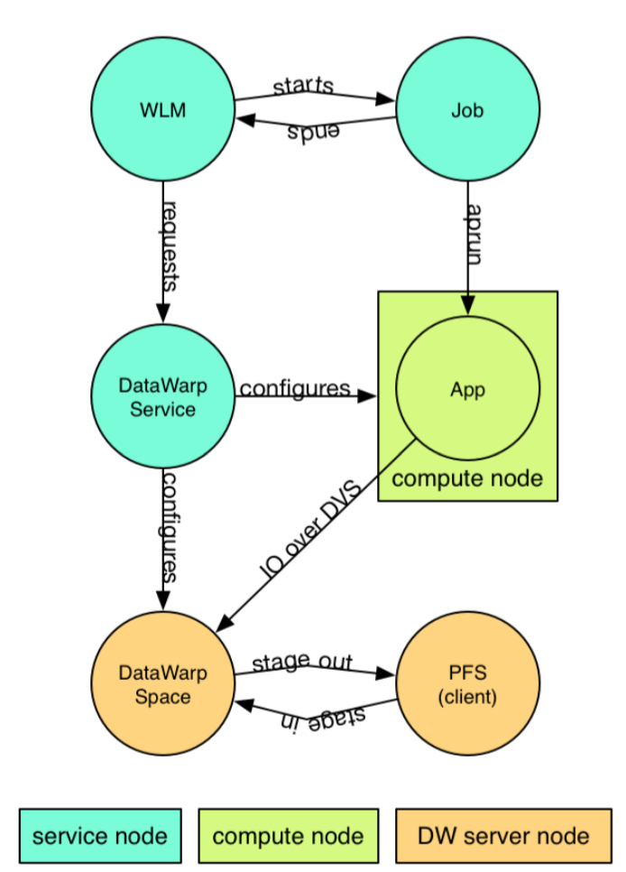
Burst Buffer Component Interaction
Notes:
1. A user submits a job to a workload manager. Within the job submission, the user must specify: the amount of DataWarp storage required, how the storage is to be configured, and whether files are to be staged from the PFS to DataWarp or from DataWarp to the PFS.
2. The workload manager provides queued access to DataWarp by first querying the DataWarp service for the total aggregate capacity. The requested capacity is used as a job scheduling constraint. When sufficient DataWarp capacity is available and other WLM requirements are satisfied, the workload manager requests the needed capacity and passes along other user-supplied configuration and staging requests.
3. The DataWarp service dynamically assigns the storage and initiates the stage in process.
4. After this completes, the workload manager acquires other resources needed for the batch job, such as
compute nodes.
5. After the compute nodes are assigned, the workload manager and DataWarp service work together to make the configured DataWarp accessible to the job's compute nodes. This occurs prior to execution of the batch job script.
6. The batch job runs and any subsequent applications can interact with DataWarp as needed (e.g., stage additional files, read/write data).
7. When the batch job ends, the workload manager stages out files, if requested, and performs cleanup. First, the workload manager releases the compute resources and requests that the DataWarp service make the previously accessible DataWarp configuration inaccessible to the compute nodes. Next, the workload manager requests that
additional files, if any, are staged out. When this completes, the workload manager tells the DataWarp service that the DataWarp storage is no longer needed.
Source: DataWarp Administration Guide S-2557-5204

Slide 6
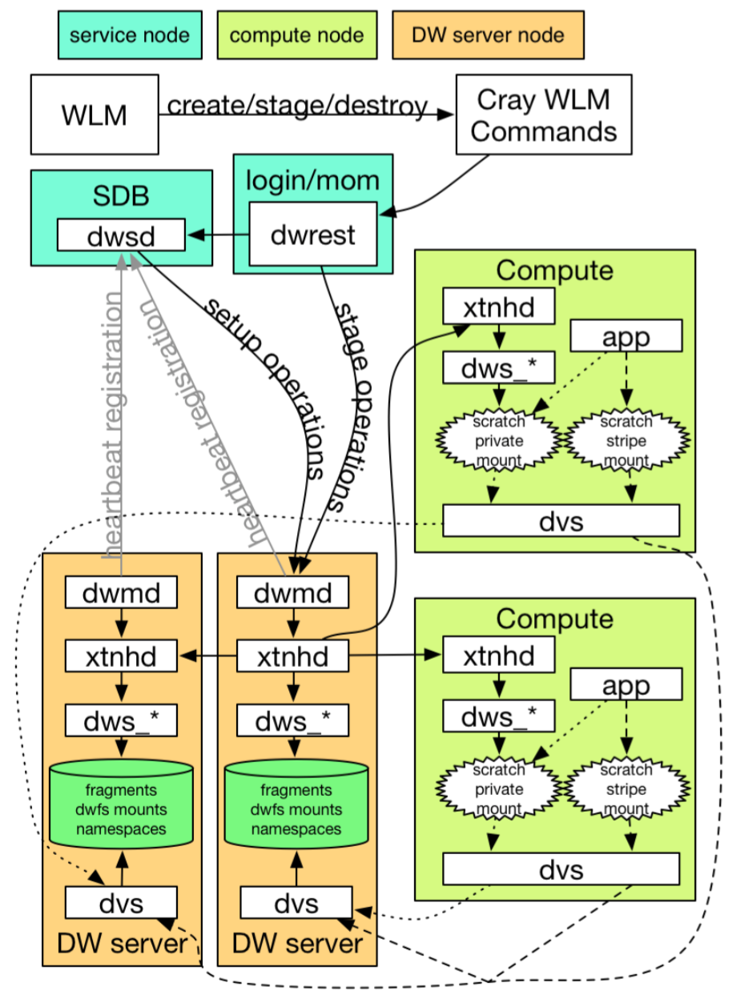
Burst Buffer Process overview
Notes:
The following diagram includes extra details regarding the interaction between a WLM and the DWS as well as the location of the various DWS daemons.
Source: DataWarp Administration Guide S-2557-5204
Many “moving” pieces – SLURM “hides” most of this from the user
1. A user submits a job to a workload manager. Within the job submission, the user must specify: the amount of DataWarp storage required, how the storage is to be configured, and whether files are to be staged from the PFS to DataWarp or from DataWarp to the PFS.
2. The workload manager provides queued access to DataWarp by first querying the DataWarp service for the total aggregate capacity. The requested capacity is used as a job scheduling constraint. When sufficient DataWarp capacity is available and other WLM requirements are satisfied, the workload manager requests the needed capacity and passes along other user-supplied configuration and staging requests.
3. The DataWarp service dynamically assigns the storage and initiates the stage in process.
4. After this completes, the workload manager acquires other resources needed for the batch job, such as
compute nodes.
5. After the compute nodes are assigned, the workload manager and DataWarp service work together to make the configured DataWarp accessible to the job's compute nodes. This occurs prior to execution of the batch job script.
6. The batch job runs and any subsequent applications can interact with DataWarp as needed (e.g., stage additional files, read/write data).
7. When the batch job ends, the workload manager stages out files, if requested, and performs cleanup. First, the workload manager releases the compute resources and requests that the DataWarp service make the previously accessible DataWarp configuration inaccessible to the compute nodes. Next, the workload manager requests that
additional files, if any, are staged out. When this completes, the workload manager tells the DataWarp service that the DataWarp storage is no longer needed.

Slide 7
Using GPFS with job script directives- #DW
#!/bin/bash
#SBATCH -n 32 -t 2
#DW jobdw type=scratch access_mode=striped capacity=1TiB
#DW stage_in type=directory source=/global/gpfs/my_in_dir destination=$DW_JOB_STRIPED
#DW stage_out type=directory destination=/global/gpfs/my_out_dir source=$DW_JOB_STRIPED
export JOBDIR=$DW_JOB_STRIPED
cd $DW_JOB_STRIPED
srun –n 32 a.out

Slide 8
The “Gotcha”
Cross mounting of all GPFS filesystems with “root squash”
Datawarp stage_in / stage_out executes as root
Requires open file access permissions to stage_in - undesirable
Cannot “stage_out” (root squash = uid of nobody) does not function
How to best overcome the issues
BoF discussion point

Slide 9

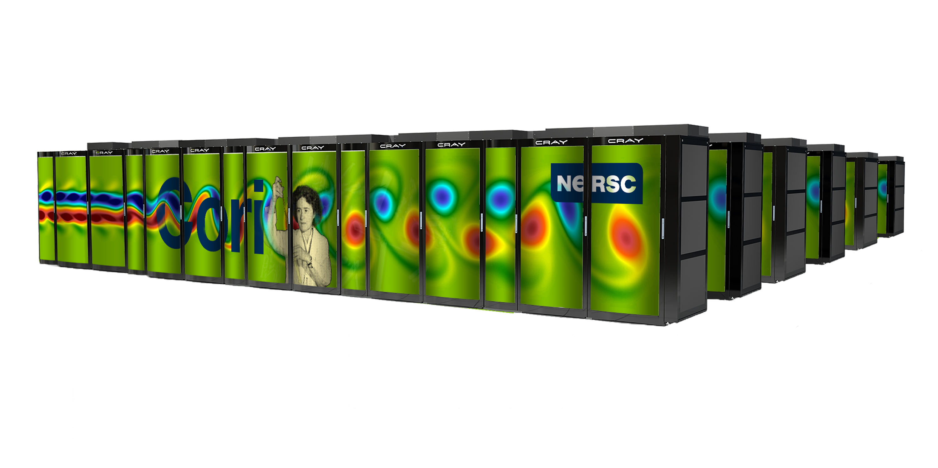
BoF Discussion

Slide 10
BoF Backup Slides

Slide 11
DWS API Client Helper (one example)
dw_wlm_cli –f
  pools: show pool information
  paths: generate environment variables to be injected into running batch job
  job_process: validate correctness of #DW directives
  setup: create session, instance, configurations
  data_in: perform stage-in activities
  pre_run: prepare compute nodes for Datawarp
  post_run: revoke compute node Datawarp access
  data_out: perform stage-out activities
  teardown: clean up all job-affiliated DW state

Slide 12
DWS dwcli vs. SLURM (one session)
# dwcli –j ls session
"created": 1473889069,
"creator": "CLI",
"expiration": 0,
"expired": false,
"id": 9711,
"links": {
"client_nodes": []
"owner": 95448,
"state": {
"actualized": true,
"fuse_blown": false,
"goal": "create",
"mixed": false,
"transitioning": false
"token": "tractorD”
# scontrol show burst | grep dpaul
Name=tractorD CreateTime=2016-09-14T14:37:49 Pool=wlm_pool Size=7200G State=allocated UserID= dpaul(95448)
Notes:
Comparing Datawarp status from “dwcli –j ls session” to SLURM status

Slide 13
Datawarp Terms
DWS ­ DataWarp Service ­ software for managing and configuring the SSD I/O installation
  Pool ­ subset of DW-servers with a common allocation granularity (ex. 200GB), ex. wlm_pool
  Session ­ typically created by a DW­enabled WLM job (Token = JobID or Name)
  Instance ­ an object representing a user’s request for disk space (ex. 600GB)
  Fragment ­ a piece of an instance, as it exists on a DW-server (ex. 3 @ 200GB)
  Configuration ­ an object representing how the space is to be used (scratch, striped, private, etc.)
  Namespace ­ represents the metadata (called tree) and data (called data), i.e. a FileSystem (DWFS)
  Registration ­ an object for linking together a session and a configuration
  Activation ­ an object representing where a configuration is to be used (i.e. mounted)
  Realm ­ group of DWFS mount points that cooperate, present what appear to be different FileSystems
DWFS ­ DataWarp FileSystem ­ a Cray FileSystem that supports staging of files and striping data across multiple DW-servers.
DVS ­ Data Virtualization Service ­ Cray’s I/O forwarding software (enables GPFS & DWFS I/O on HSN)
XFS ­ FileSystem used to persist data flowing through DWFS
DW-Server – DVS server with SSDs, DWS, DWFS, XFS, LVM and access to a PFS
Notes:
Datawarp Overview:
Namespace ­ a DWFS term that represents the metadata (called tree) and data (called data) of what one normally thinks of as a FileSystem. There can be many namespace
data, each of which is on a different DW server node
Source: DataWarp Administration Guide S-2557-5204

Slide 14
SLURM – (one command to bind them all)
# scontrol show burst
Name=cray DefaultPool=wlm_pool Granularity=200G TotalSpace=765600G UsedSpace=50400G
AltPoolName[0]=tr_cache Granularity=16M TotalSpace=61047200M UsedSpace=6842000M
Flags=EnablePersistent,TeardownFailure
StageInTimeout=86400 StageOutTimeout=86400 ValidateTimeout=5 OtherTimeout=300
GetSysState=/opt/cray/dw_wlm/default/bin/dw_wlm_cli
Allocated Buffers:
Name=udabb CreateTime=2016-08-28T13:33:26 Pool=wlm_pool Size=10400G State=allocated UserID=dgh(93131)
Name=rfmip_modat CreateTime=2016-08-30T21:18:23 Pool=wlm_pool Size=12400G State=allocated UserID=dfeld(96837)
Name=dpaul_tr CreateTime=2016-08-22T12:38:59 Pool=tr_cache Size=800G State=allocated UserID=dpaul(95448)
JobID=0_0(2793398) CreateTime=2016-08-31T00:28:50 Pool=(null) Size=0 State=allocated UserID=dfeld(96837)
JobID=2971140 CreateTime=2016-09-09T14:10:26 Pool=wlm_pool Size=1200G State=teardown UserID=kim(97002)
Per User Buffer Use:
UserID=dgh(93131) Used=10400G
UserID=dfeld(96837) Used=12400G
UserID=dpaul(95448) Used=800G
UserID=kim(91002) Used=1200G
Notes:
wlm_pool
alternate pool
flags
Name= PR
JobID with Pool=(null) Size=0 means it’s using a PR
username (uid)
Add teardown

Slide 15
SLURM configuration for Datawarp (very simple)
slurm.conf : BurstBufferType=burst_buffer/cray
burst_buffer.conf :
  DefaultPool: name of the pool used by default for resource allocations
    wlm_pool
  AltPoolName: allows for different storage configurations (ex. Granularity size)
  DenyUsers: list of user names and/or IDs prevented from using burst buffers
  Flags EnablePersistent: allows users to create/destroy persistent burst buffers
  Flags TeardownFailure: remove DW allocation on job failure
QoS/TRES – control user access, user quotas, usage and report them
Notes:
bb/cray – TRES trackable resource

Slide 16
DWS dwstat (administrator focused)
# dwstat most
==============================================
pool units quantity free gran
tr_cache bytes 5.82TiB 5.82TiB 16MiB
wlm_pool bytes 809.96TiB 627.34TiB 200GiB
sess state token creator owner created expiration nodes
9708 CA--- 2993022 SLURM 90891 2016-09-14T14:27:48 never 8
9710 CA--- tractorD CLI 95448 2016-09-14T14:31:43 never 0
inst state sess bytes nodes created expiration intact label public confs
1943 CA--- 9708 27.73TiB 142 2016-09-14T14:27:48 never true I9708-0 false 1
1945 CA--- 9710 27.73TiB 142 2016-09-14T14:31:43 never true tractorD true 1
Notes:
Equalize_Fragments effect = 27TiB

Slide 17
SLURM configuration for Datawarp (very simple)
slurm.conf : BurstBufferType=burst_buffer/cray
burst_buffer.conf :
  DefaultPool: name of the pool used by default for resource allocations
    wlm_pool
  AltPoolName: allows for different storage configurations (ex. Granularity size)
  DenyUsers: list of user names and/or IDs prevented from using burst buffers
  Flags EnablePersistent: allows users to create/destroy persistent burst buffers
  Flags TeardownFailure: remove DW allocation on job failure
QoS/TRES – control user access, user quotas, usage and report them
Notes:
bb/cray – TRES trackable resource

