Slide 1
Spectrum Scale and Virtualization
Discussion April 5 2017
John Lewars, Spectrum Scale Cloud and Object Team
This is intended to be a dialogue to seek your input.

Slide 2
The information presented on these charts does not represent any official commitment in terms of Spectrum Scale future direction or deliverables.
  IBM’s statements regarding its plans, directions, and intent are subject to change or withdrawal without notice at IBM’s sole discretion.
  Information regarding potential future products is intended to outline our general product direction and it should not be relied on in making a purchasing decision.
  The information mentioned regarding potential future products is not a commitment, promise, or legal obligation to deliver any material, code or functionality. Information about potential future products may not be incorporated into any contract.
  The development, release, and timing of any future features or functionality described for our products remains at our sole discretion.

Slide 3
Why Cloud?
Why do we think that it’s important for the Spectrum Scale team to have a presence in the cloud?
(Recall this is a discussion and any assertions we make on these charts are intended to be discussion points and solicit feedback.)
Our observations:
  Workloads seems moving to the cloud (private and public).
  We want to offer support for Scale in cloud environments that our customers are moving to (this is part of our hybrid strategy).
Question for the room: How many of you are have mandates to move to private and public clouds?
How are you engaging in this area? What, if any, private and public clouds are you working with?
Notes:
3
3
3

Slide 4
Spectrum Scale Cloud Work Goals
Value proposition of Spectrum Scale: Software data management & global name space, available through multiple methods, on a variety of platforms with flexible storage back-ends, delivering highly scalable performance and robustness in clustered environments.
Goals of Cloud Project
Deliver Spectrum Scale’s value proposition on existing Cloud Environments and expand the flexibility of our offerings to better support hybrid environments.
  Support available Spectrum Scale offerings on SoftLayer and support/collaborate regarding new offerings based on Scale
  Investigate options for Spectrum Scale support of Amazon (AWS)
  Investigate what it takes to deliver an offering Azure
  Support OpenStack Cloud environments with Cinder & Manila drivers and investigation of best practices (e.g. multi-tenancy recommendations and accessing Spectrum Scale data from VMs)
Support and enhance our OpenStack Swift based Spectrum Scale Object Storage solution which expands the methods by which Spectrum Scale data can be accessed.
Investigate better integration, and more flexible support of storage for, virtualized environments (including containers)

Slide 5
Spectrum Scale Cloud Plays
Options for Spectrum Scale in the Cloud
 | 1a.) Spectrum Scale as a backend file store for IBM cloud services | 1b.) Spectrum Scale in managed public cloud deployments “On Cloud” | 2.) Spectrum Scale in OpenStack private clouds | 3.) Cluster as a Service with Spectrum Scale | 4.) File Storage as a Service with Spectrum Scale
 | Custom Solution Stack in Public Cloud |  | Private Cloud | *-as-a-Service
What is MVP | Storage rich server based recommended architecture, Workload specific tuning guidance |  | - Development and validation of required drivers and integration points - Certification with key distribution (Bluebox/ Mirantis/ RDO) | - Provision a Single tenant, dedicated Spectrum Scale cluster on a public cloud without manual intervention - Ability to upload data using NFS/Object - Run compute jobs on cluster | - Provide file storage as service based on some SLAs in Softlayer/Bluemix - Solve multitenancy problem
Examples/ Details | Scale as a backend for bluemix dashdb/ Spark/ Watson Health services | Prana usecase, or any managed cloud deployment in Softlayer/ Amazon requiring clustered file system | CLIMB, eMedLab, Uvictoria, internal XCloud in CDL | Spectrum Scale Amazon AMI Cluster as a Service on Bluemix/Amazon | - File service on bluemix - Architecturally possible to implement Offprem as well as Onprem - Similar to Amazon EFS?
What do we have today | Recommendation on architecture choices (redpaper) |  | Redpaper for deployment guidance, Cinder driver, Manila driver | Working prototype of Amazon AMI | -

Slide 6
Spectrum Scale SoftLayer Cloud Engagement
  Team has engaged with Spectrum Scale customers using SoftLayer to support these strategic use cases. Some examples:
    Supported Prana Animation Studio to do ‘cloudbursting’ for temporary workload resource needs using approximately 900 bare metal servers running on SoftLayer:
    https://www-03.ibm.com/press/in/en/pressrelease/50966.wss
    We have enabled IBM teams to use Spectrum Scale as part of their solutions offered on SoftLayer, e.g.:
      DashDB database solution needs clustered file system and also leverages Spectrum monitoring functions (e.g. Spectrum Scale detects node failures and facilitates running of callbacks in response to system events):
      https://www.ibm.com/support/knowledgecenter/SS6NHC/com.ibm.swg.im.dashdb.doc/admin/local_filesystem.html
      The IBM Platform Computing Cloud service solution is a managed HPC computing service that uses Spectrum Scale:
      http://www.redbooks.ibm.com/redpapers/pdfs/redp5214.pdf
      Supported Cloud Data Spark Service’s use of Spectrum Scale.
        We are now exploring options for providing a NFS based storage service (backed by Spectrum Scale) for a variety of workloads (e.g. Bluemix services running in containers).

Slide 7

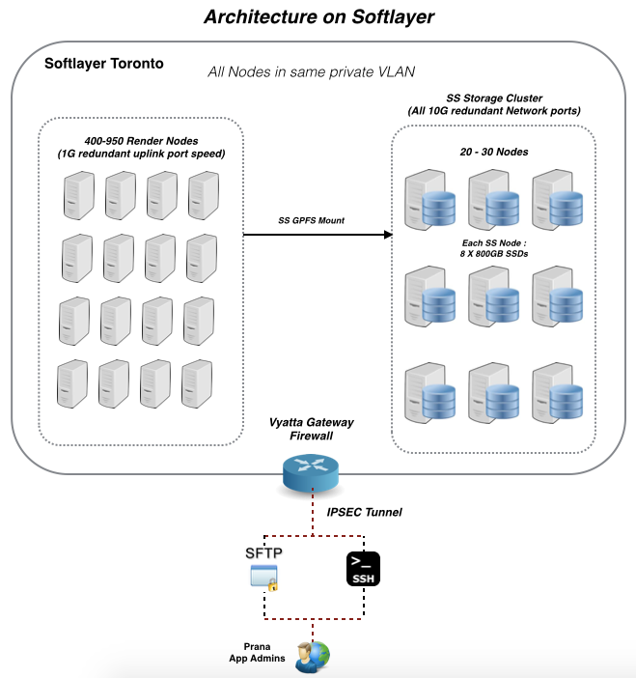
Prana Studio – Spectrum Scale on SoftLayer:
AP/India, Media & Entertainment, USD 1.274 Mill + (over 3 months)
Challenge
Animation & VFX rendering is a compute intensive activity. It takes hundreds of thousands of machine hours to render the frames requires to make an animation movie of visual delight.
Maintaining such high numbers of compute power on-premise is a close to impossible task both financially and technically for animation studios like Prana.
Apart from compute power, high performance storage is another major factor for the success of VFX rendering. The typical requirement of storage is to deliver 200K aggregate IOPS, with minimal or no outage, running continuously for at least 3-4 months during the rendering phase.
Proposed Solution Architecture
SW Components
  Spectrum Scale 4.2.0.2
  Vyatta 6.7
  xCAT 2.11
HW components
  25 x Spectrum Scale servers (local SSD, 2x 10Gbps Ethernet)
  800 x Rendering nodes (Spectrum Scale client, 2x 1Gbps Ethernet)
Aggregated throughput > 10GB/s
Dual Ethernet interfaces (bond mode 4) provide robust communication channel
IBM Differentiation
Our competitor is Google + Avere. Google provides infrastructure support, and Avere provides storage support.
Win points over competition :
  With the advantage of bare metals & Spectrum Scale technology, the overall performance was much higher than our competitor’s solution in same infrastructure size.
  The “one IBM team” approach was the key to this win, as the cloud team and the systems group worked closely on the POC with the client and demonstrated our passion for winning this.
Solution
IBM Cloud group and System group worked closely to come out an integrated cloud based “render farm” on SoftLayer:
  Offer high performance computer power which can satisfy client computer intensive applications.
  High performance parallel file system which can support concurrent IO operations from 800+ compute nodes.
  Meet the budget constraints by leveraging the ‘pay-as-you-go’ model of cloud for the necessary duration
Our unique values:
  High performance compute cluster based on bare-metal machines. Guarantee performance.
  Robust & mature enterprise class parallel file system, with unlimited scalability and proven stability.
IBM has rich HPC experience in various of traditional industries. But this is the first time to implement such scale env on cloud.
This solution can be replicated to other movie rendering clients, and clients in many other industry.
Traditionally we use SAN storage to support HPC applications, and use local disk to run BigData applications. This time we are using local disk to support HPC workload.

Slide 8
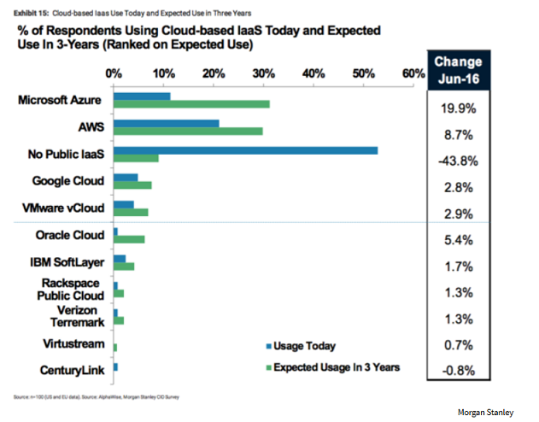
Discussion on Where Market Data Suggests Cloud Dollars
Are Heading
http://www.networkworld.com/article/3091083/cloud-computing/microsoft-could-overtake-amazon-in-the-cloud-morgan-stanley-survey-finds.html#tk.rss_cloudcomputing

Slide 9
Spectrum Scale Cloud Work Items Beyond SoftLayer
Spectrum Scale on AWS
  Testing of Spectrum Scale on AWS instances using EBS volumes
  Developing CloudFormation deployment methods for Spectrum Scale clusters
  Investigating providing Spectrum Scale support on AWS initially as a trial offering delivered via an AMI, not for production, that we can share with customers via Amazon’s AMI sharing facility
  Developing guidance for troubleshooting issues with the AWS infrastructure and worked with L2 team to ensure we’re ready to support the AWS environment
  Collecting baseline scaling performance data for Spectrum Scale running on EC2 instances using EBS volumes
Develop a plan for Spectrum Scale support on Azure.
  Learning about storage and compute services provided by Azure
  Prototyping the use of Spectrum on Azure

Slide 10
AWS Spectrum Scale Using EC2 Instances Backed by EBS
EBS
volume
Network Connection tor Non-EBS traffic
EC2 Instance
(Application Node)
EC2 Instance
(NSD Server)
[. . . ]
EBS
volume
EC2 Instance
(Application Node)
[. . . Additional servers]
Network EBS connection
EBS
volume
EC2 Instance
(Application Node)
EC2 Instance
(NSD Server)
[. . . ]
[. . . Additional clients . . . ]
EBS
volume

Slide 11
Deployment Comparison Between Manual and Automated Approaches
Choose template base AMI for OS
Choose Spectrum Scale AMI and GPFS AWS CloudFormation template
Manually
Automatically
An admin with good AWS and Spectrum Scale skill needs few hours to setup a 10 node cluster
Input Instance parameters:
How many EC2, EBS, NIC…
An admin with basic AWS and Spectrum Scale skill only needs 15 to 30 minutes to setup a 10 nodes cluster
Input Instance and Scale cluster/fs parameters
Boot up instance
Upgrade, config each instance. Install Scale package in each instance.
Create Scale cluster using CloudFormation Stack that uses our script internally
Create Scale cluster and file system
Scale cluster and fs ready
Scale cluster and fs ready

Slide 12







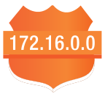



Delivery on Amazon Use CloudFormation
  Goals: Deploy a cluster filesystem on Amazon AWS/EC2 using EBS
  What does it provide: Ability to quickly launch a “scalable” workload in the cloud that needs cluster filesystem
Ec2-create-volume
EC2 Instance
Ec2-attach-volume
GPFS binaries
/usr/bin/gpfsaws.sh
ec2-create-nic
OS pre-config
/etc/gpfsaws.conf
Ec2-attach-nic
GPFS auto deploy scripts
(/usr/bin/gpfsaws.sh)
SpectrumScale
AMI
AutoScalingGroup
Mm commands
Elastic
Network
Interface
EBS
GPFS Cluster
GPFS File system
Parameters:
NodeCount
DiskPerNode
EBSType
…
VPC
ENI
ENI
User
Input
ENI
CloudFormation
Subnet
Route
GPFS AWS
CloudFormation
Template
(gpfsaws.template)
IAM
SecurityGroup

Slide 13
Data Ingest Options for Spectrum Scale Clusters on AWS
Src data volume
Option A
Copy data through network
EC2
Option B
Upload data into AWS S3.
Copy data from S3 in each Spectrum Scale cluster node through S3 API.
NSD EBS from previous deployment
EC2
EBS
AWS S3
S3 API
Option C
If data has already saved in file system. And compute resource is not needed any more. Just destroy instance but keep EBS for NSD.
Recovery this NSD for new cluster when saved data needs to access or process again.
Spectrum Scale Cluster

Slide 14
AWS Spectrum Scale Using EC2 Instances
Backed by EBS – Hardware Failures that
Do Not Involve EBS Volumes
GPFS EBS
volume
EC2 Instance
(NSD Server)
EBS Root volume
GPFS EBS
volume
Network EBS connection

Slide 15
AWS Spectrum Scale Using EC2 Instances
Backed by EBS – Hardware Failures that
Do Not Involve EBS Volumes
GPFS EBS
volume
EC2 Instance
(NSD Server)
EBS Root volume
EC2 Instance
(NSD Server)
GPFS EBS
volume
Network EBS connection
In the case of a hardware failure leading to termination of an EC2 instance, if the hardware failure is not tied to an EBS volume used by the instance, simply restarting the instance should allow it to be launched on new hardware, using the same EBS root volume and GPFS data disks.

Slide 16
Options for Handling Failures on EBS Volumes Used by Spectrum Scale
1. Run without any Spectrum Scale replication but this assumes a willingness to accept potential data loss if an EBS volume used for GPFS data/metadata fails. (This approach assumes that snapshots/backups of the Scale data are taken to allow recovery from such failures). The SLA Amazon provides for EBS volumes should be carefully reviewed before choosing this option.
From https://aws.amazon.com/ebs/details/#elasticvolumes:
  Amazon EBS volumes are designed for an annual failure rate (AFR) of between 0.1% - 0.2%, where failure refers to a complete or partial loss of the volume, depending on the size and performance of the volume. This makes EBS volumes 20 times more reliable than typical commodity disk drives, which fail with an AFR of around 4%. For example, if you have 1,000 EBS volumes running for 1 year, you should expect 1 to 2 will have a failure.
See Amazon EC2 and EBS Service Level Agreement. for full details
2. Use Spectrum Scale replication to replicate all GPFS EBS volumes used by GPFS. Two-way data and metadata replication is suggested, but other options could be considered, depending on data protection requirements (e.g. 2 way data replication and 3-way metadata replication will allow the filesystem to stay mounted, should two separate NSD servers experience failures related to GPFS EBS volumes).
In the case of an EBS volume used by GPFS failing, the ‘mmrestripefs –r’ command can be used to re-replicate data across the disks and restore the cluster replication levels.

Slide 17
AWS Spectrum Scale Using EC2 Instances Backed by EBS
EBS Root Volume Hardware Failures
GPFS EBS
volume
EC2 Instance
(NSD Server)
EC2 Instance
(NSD Server)
EBS Root volume
GPFS EBS
volume
Network EBS connection
  A hardware failure causing the loss of an EBS root volume will result in the termination of an EC2 instance, thereby preventing that instance from being reactivated. The loss of any GPFS data volumes in such a failure case can be handled as per the previous slide’s recommendations. Alternatively, (but this requires unmounting the filesystem), any EBS volumes assigned to the failing instance can be reassigned via mmchnsd to existing instances in the cluster or a new instance can be activated to replace the failed instance.

Slide 18
Spectrum Scale Cloud Related Guides
  The Spectrum Scale team has developed some documentation regarding use of Spectrum Scale in Cloud environments.
  Team has provided Guide for running Spectrum Scale on SoftLayer systems:
  http://www.redbooks.ibm.com/redpapers/pdfs/redp5410.pdf
  Team has provided OpenStack Redpaper:
  http://www.redbooks.ibm.com/redpapers/pdfs/redp5331.pdf
  Team has produced Redpaper for Spectrum Scale Unified Object Access :
  http://www.redbooks.ibm.com/abstracts/redp5113.html
  Knowledge center OpenStack documentation for Spectrum Scale:
  https://www.ibm.com/support/knowledgecenter/en/STXKQY_4.2.1/com.ibm.spectrum.scale.v4r21.doc/bl1ins_openstackusecase.htm

Slide 19
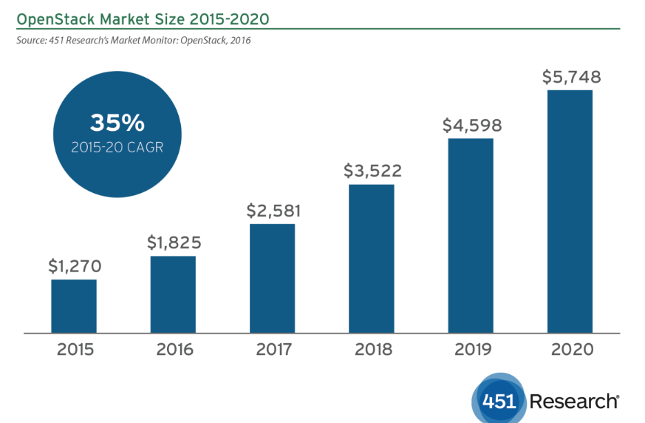
OpenStack Projected Growth Rate from 451 research.com
OpenStack private cloud revenue continues to grow at +30% CAGR.
  https://451research.com/images/Marketing/press_releases/10.24.16_OpenStack_Pulse_PR_Final.pdf

Slide 20
High Level Strategy for OpenStack
  Support OpenStack Cloud environments with Cinder & Manila drivers and investigation of best practices (e.g. multi-tenancy recommendations and accessing Spectrum Scale data from VMs)
  Questions:
  Who is using OpenStack now?
  Why are you using it or why are you not using it?
  Are you thinking about using it in the future?
  What would you like to see from Spectrum Scale in terms of OpenStack support?
Notes:
20
20
20

Slide 21
High Level Strategy for Virtualization
  Investigate better integration, and more flexible support of storage for virtualized environments.
  Team has submitted changes for the GPFS FAQ which describes virtualization support and is currently investigating various use cases for VMs in the context of Vmware and OpenStack solutions. Upcoming planned items include SR-IOV support, investigations into support restrictions around VMDK on GPFS NSD servers, etc
  Questions:
  What virtualization technologies are you using now?
  Why are you using these technologies and/or what inhibitors are there to you using virtualization with Spectrum Scale?
  Are you thinking about using new virtualization technologies in the future?
  What would you like to see from Spectrum Scale in terms of virtualization support?
Notes:
21
21
21

Slide 22
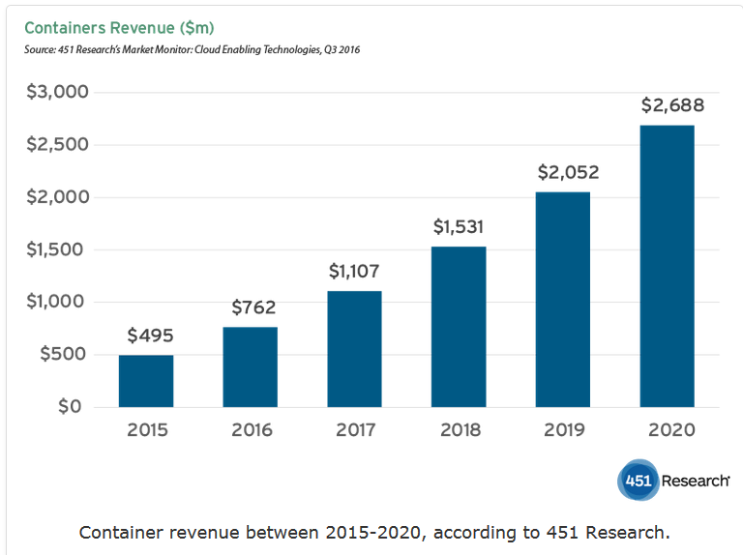
Container Projected Growth Rate per 451 Research
Containers growth predicted to be at high rate:
  http://www.itworldcanada.com/article/application-container-market-small-but-mighty-451-research-says/389916

Slide 23
High Level Strategy for Containers
Team is has done investigations into using GPFS and NFS (of GPFS file systems) in a variety of environments, including Kubernetes, Docker Swarm, and Spectrum Compute’s Conductor for Containers (which uses Kubernetes)
The team is looking at doing work with Mesos and Open Shift next (Singularity may be on the list as well) in addition to contributing to the effort to productize the Ubiquity driver
https://github.ibm.com/almaden-containers/ubiquity
https://github.ibm.com/almaden-containers/ubiquity-k8s
Questions regarding container usage:
  Are you using containers and, if so, what kinds of workloads are you running with them?
  How do you see containers and cloud coming together?
  For example, how do you see containers fitting into use cases you may be looking at on Amazon or Azure?
  What orchestration method(s) (e.g. Kubernetes, Docker Swarm) are you looking at?
Notes:
23
23
23

Slide 24
Backup

Slide 25
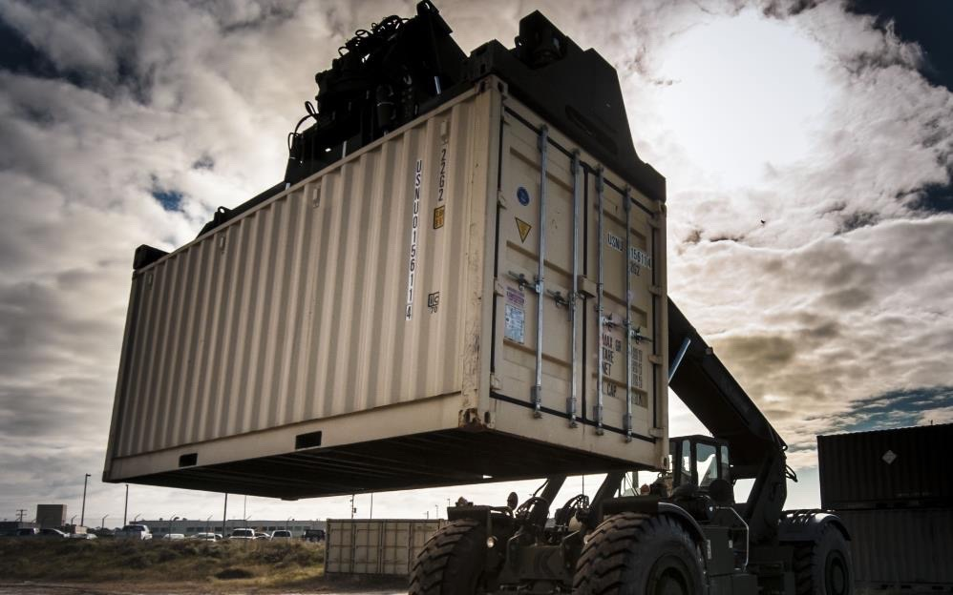
Containers (next 7 charts are from Dean Hildebrand)
Standard way to package an application and all its dependencies
Portable between environments and run without changes
Isolate unique elements to enable a standardize infrastructure
Fast and lightweight
Notes:
Containers are not new… technology goes back 10+ years in Linux.. With key contributions from IBM, Google, Sun and others
Docker is the most popular instance of Containers in the industry

Slide 26
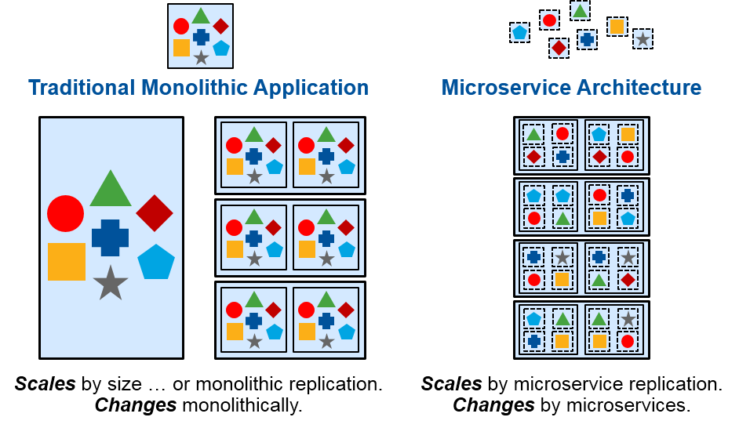
Containers, Containers, Containers
HPC and Scientific Computing
  Portable and reproducible science
  One-Click Laptop to Supercomputer
On-premise and Public Clouds
  Scheduling and Auto-Scaling
  Improved resource utilization
  Isolation and Multi-Tenancy
Development, DevOps and continuous integration
  Re-use of applications and services
  Simplify and accelerate application deployment
Next Gen, Micro-Service, and Traditional Applications

Slide 27

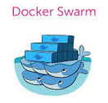


New Gen Application, Framework, and Storage EcoSystem
Applications and Services
Traditional Apps
Framework
POSIX
HDFS
NFS
SMB
Swift/S3
Storage
SSD
Fast
Disk
Slow
Disk
Tape

Slide 28



Ubiquity Container Volume Service
Unified File Management
Need a unified storage experience across runtimes
28
Unified Data Access Experience across Cloud runtimes
Customized scale out capacity and performance
OpenWhisk
PaaS Runtime
CaaS Runtime
Virtual Machines
Bare Metal
Event-driven apps,
deployed in a
serverless environment.
App-centric runtime
environments based on
Cloud Foundry.
Portable and consistent
delivery of your app
without having to manage an OS.
Get the most flexibility
and control over your
environment with VMs.
For the ultimate
performance and scale
POSIX
HDFS
NFS
SMB
A unified storage experience across runtimes
Notes:
The long tail of analysis of your data

Slide 29
Ubiquity Container Volume Service Architecture
Storage Provisioning
Docker/Swarm
Docker, Kubernetes, and Custom APIs
Docker CLI
(create/remove volume)
Provisioning APIs
Create
Delete
List
Ubiquity Storage Service
Ubiquity Plugin
Spectrum Scale Native and NFS
OpenStack Manilla and Cinder
Block Storage
Access Mgmt APIs
Attach
Detach
List
Storage Orchestrator
Kubernetes
K8s Dynamic Provisioning CLI
Custom APIs
ACLs
QoS
Snapshot
PVs
Ubiquity checks for new persistency volume claims in K8s every 30s
Ubiquity storage service can be deployed in a variety of ways as required by storage system and container framework

Slide 30
Ubiquity Container Volume Service Architecture
Storage volume drivers are needed to abstract storage complexities while exposing key capabilities
Each container framework has different mechanisms for provisioning storage
  Build a single driver that can ‘link’ to each framework allowing access to single dataset across all frameworks
General architecture to support…
  A variety of storage services
    Initially supporting shared file services
    Plan to also support shared block storage as well
  A variety of container frameworks
    Docker and Docker Swarm (DDC)
    Kubernetes (and any framework that packages it such as Redhat OpenShift, Spectrum Conductor for Containers)
      Support FlexVolume and Dynamic Provisioning driver
Support existing or new volumes
Plan is to open-source framework and drivers
  Continual testing and community participation will be required
Docker, Kubernetes, and Custom APIs
Provisioning APIs
Create
Delete
List
Ubiquity Storage Service
Spectrum Scale Native and NFS
OpenStack Manilla and Cinder
Block Storage
Access Mgmt APIs
Attach
Detach
List
Storage Orchestrator
Custom APIs
ACLs
QoS
Snapshot

Slide 31
Ubiquity Container Volume Service Architecture
Storage Access Management
Docker, Kubernetes, and Custom APIs
Docker/Swarm
Docker/Swarm
Provisioning APIs
Create
Delete
List
Ubiquity Storage Service
Docker CLI
(run)
Spectrum Scale Native and NFS
OpenStack Manilla and Cinder
Block Storage
mount/unmount
Access Mgmt APIs
Attach
Detach
List
Ubiquity Plugin
Storage Orchestrator
Custom APIs
ACLs
QoS
Snapshot
Kubernetes
Ubiquity FlexVolume Driver
mount/unmount
Ubiquity storage service can be deployed in a variety of ways as required by storage system and container framework

Slide 32
The Case for Docker in HPC Environments
Running a new application, even on a machine one is very familiar with, is often an exercise in resolving dependencies. To ge a new application running, one may have to, for example, assemble the combinations of:
    MPI and OpenPM libraries
    GPU support (e.g. CUDA, OpenGL)
    Compilers and run time support
    Other version dependencies (e.g. perl, python, etc.)
On an HPC environment, where multiple users share a system, it’s often up to the users to work directly with system administrators to pull together the right dependencies for a given application. This process can take a considerable amount of time.
The difficulty in moving applications between different systems/software stacks, and the associated testing overhead this problem creates for software development, is the major reason behind the creation of Docker, and has been a driver for the adoption of Docker in HPC environments:
“The value here, as it’s been proven out in mainstream IT and now HPC is that the admin’s job becomes far simpler than before in that she is freed from deploying the many applications that
might be running on the cluster—it becomes a matter of creating the Docker images, moving them into the repository, then allowing the scheduler, in this case LSF, orchestrate the rest.”
(from: http://www.nextplatform.com/2015/03/23/hpc-schedulers-snap-to-docker/)

Slide 33
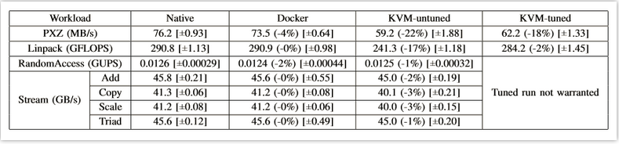
The Case for Docker in HPC Environments (2)
Another benefit of using Docker is the workload management aspect of containerization. Containers have been well demonstrated to provide some of the isolation benefits of VMs, but with much lower overhead:
          Source: http://domino.research.ibm.com/library/cyberdig.nsf/papers/0929052195DD819C85257D2300681E7B/$File/rc25482.pdf
Docker integrates the use of control groups with its change management features, allowing users to wrap up the resource requirements of a job and provide a repeatable, portable method of running a given application.
The ability to run a job in a reproducible manner is very important aspect. . . Docker provides the benefit of a source control mechanism, like a git environment, for container development, allowing the changes to an application and its environment to be carefully managed. This increased portability can be beneficial when running on different systems (which may become more common as Cloud computing continues to develop)

Slide 34
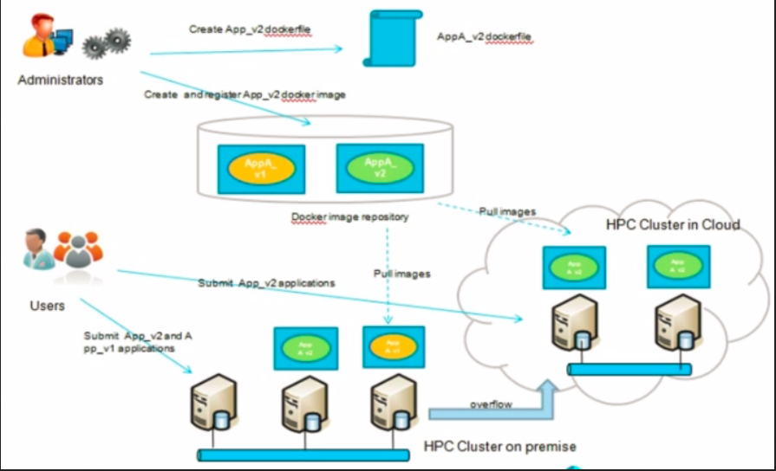
The Case for Docker in HPC Environments (3)
This is the vision of Docker usage described in “The Next Platform, March 2015”. . The implication is that we expect more data movement and more diverse compute environments as we move forward with HPC cloud enablement.
This slide is presented to generate discussion. . . Is this a vision others share?

Slide 35
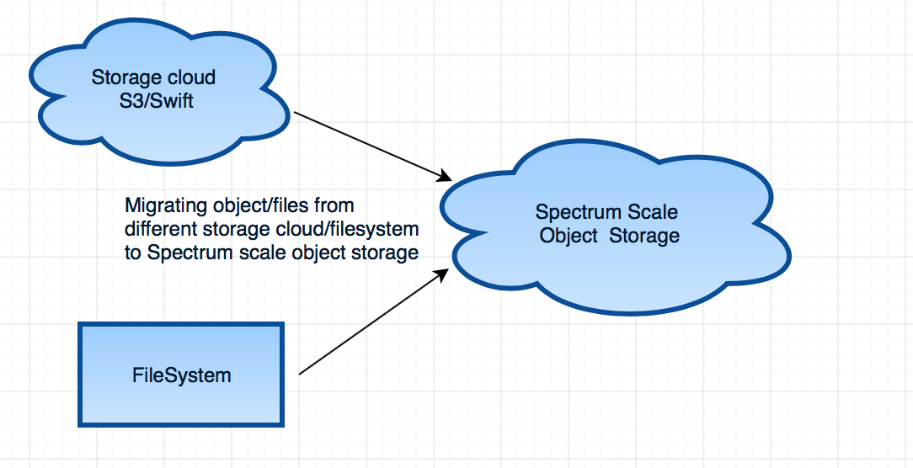
Spectrum Scale Object: Key Features
Multi-Protocol access to same data (Posix, NFS, SMB, Swift, S3)
Multi-Region active-active global cluster
Multi-Region object caching (AFM)
Amazon S3 API support
Tape Out support via LTFS (tiering) and TSM (backup)
Data migration tool for migrating data from other storage systems (on/off-prem) to Spectrum Scale Unified File and Object
Native file based object encryption
Object compression
Support for RHEL and Ubuntu (in progress) platforms
Heat based object tiering
Hybrid Cloud play – Can tier its data to IBM COS / Softlayer / Amazon via TCT
Future roadmap candidates
  Aspera Integration
  WORM (Immutability Support)
  High Latency Media Support
Notes:
35
35
35

Slide 36
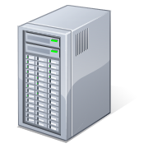


Spectrum Scale Object: Top Use Cases
Thin-Thick storage capacity site deployments for Object data
  Successful deployment at Yahoo Japan (Caching between Japan and US sites)
Spectrum Scale Cluster with Protocol Nodes (Object Enabled)
Spectrum Scale Cluster with Protocol Nodes (Object Enabled)
Object Data can be accessed as Files using Unified file and Object Feature and used for analytics
Spectrum Scale
AFM (IW) Relationship with
cache eviction enabled on Site 1
Site 1
Central Site
Centralized Analytics
Object Data
…
Applications
Limited storage
Unlimited storage
Centralized Backup
Data can be centrally backed to Tape
https://www.linkedin.com/pulse/ibm-spectrum-scale-makes-news-japan-smita-raut
Notes:
36
36
36

Slide 37
Potential Customer Genomics Use Case
HPC Cloud
1 / 10 / 40Gb
Campus User
Network
1Gb
Hardware / OS / IPMI Cluster Mgmt
POWER8
P100 GPU
NVLink
Server Pool
POWER8
Compute
Server Pool
Fat Mem
POWER8
Compute
Server Pool
Norm Mem
x86
Compute
Servers
10 Gb
Spectrum
Storage
Network
2x User Login Nodes
- Job submission (CLI / GUI)
- Workflow submission (CLI / GUI)
- Application Center
2x Management Nodes
- Job Scheduling / Dispatch
- Cluster Management (SCF / xCAT)
- Workflow Management
- RTM for monitoring & reporting
2x Data Gateway Nodes
- Data transfer
100Gb
EDR
Infiniband
Leaf and Spine Switches
Existing
Spectrum Storage
Implementation
PoC
Automatic
Tiering to:
SSD
Fast HDD
HiCap HDD
Tape Archive
Cleversafe

Slide 38
Thanks!

