Slide 1
IBM Spectrum Scale™ User Group
Spectrum Protect on Spectrum Scale
Jason Basler
IBM Spectrum Protect Development

Slide 2
About the speaker:
  Jason Basler is the test architect responsible for IBM Spectrum Protect™. He has been part of the development team for over twenty years, and has expertise in various Spectrum Protect technologies as well as related storage technologies. He is currently driving the test activities around new releases of Spectrum Protect with a focus on scalability and publishing blueprints based on best practices derived from experience in the test labs.

Slide 3
IBM’s statements regarding its plans, directions, and intent are subject to change or withdrawal without notice at IBM’s sole discretion.
Information regarding potential future products is intended to outline our general product direction and it should not be relied on in making a purchasing decision.
The information mentioned regarding potential future products is not a commitment, promise, or legal obligation to deliver any material, code or functionality.
Information about potential future products may not be incorporated into any contract.
The development, release, and timing of any future features or functionality described for our products remains at our sole discretion.

Slide 4
Agenda
Overview of solutions combining IBM Spectrum Scale™ and IBM Spectrum Protect ™
Using IBM Spectrum Protect to protect data in IBM Spectrum Scale
Using IBM Spectrum Scale as Storage for IBM Spectrum Protect
  Blueprints for disk-based data protection solutions
  The IBM Elastic Storage Server blueprint

Slide 5
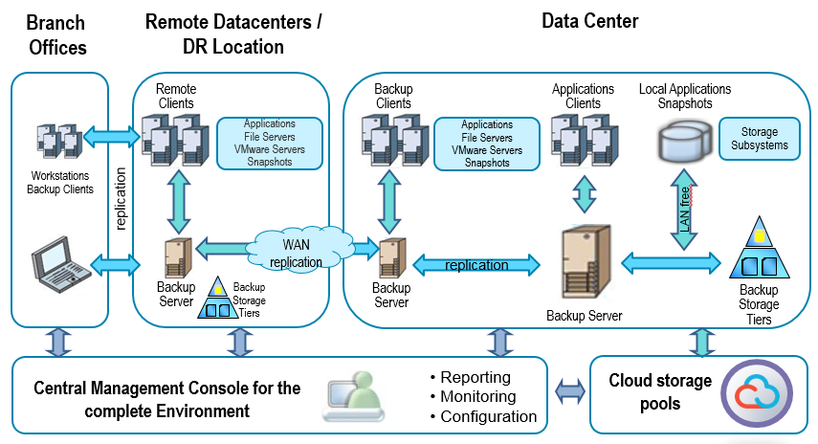
IBM Spectrum Protect™ – (formerly IBM Tivoli® Storage Manager)
Comprehensive backup and recovery suite for physical, virtual and cloud environments
Notes:
In case you haven’t heard, IBM Spectrum Protect, formerly TSM, formerly ADSM …
Comprehensive data protection and recovery solution for virtual, physical and cloud data
Over 20 years experience protecting some of the world’s largest data centers
Over 20,000 active clients
Key Capabilities
Protects virtual, physical, bare metal and cloud data with one solution
Reduces backup and recovery infrastructure costs by up to 38 percent
Delivers greater visualization and administrator productivity
Simplifies backups by consolidating administration tasks
Client values:
Application-aware and VM-aware data protection for any size organization
Built-in efficiency features: Deduplication, incremental ‘forever’ backup
Integrated multi-site replication and disaster recovery
Simplified administration

Slide 6




Spectrum Protect / Spectrum Scale Integration Overview
... for data protection of IBM Spectrum Scale
Spectrum Scale
Spectrum Protect
backup archive client
Spectrum Protect
Snapshot
SOBAR
(Scale out backup and restore)
Spectrum Protect
Server
Spectrum Scale
Spectrum Protect for
Space Management
Spectrum Scale
... as storage for IBM Spectrum Protect
Spectrum Scale
Notes:
There are 4 solutions combining Scale and Protect … I will be discussing two of them in detail
Brief mention of 1) space management 2) snapshot management (Spectrum Protect Snapshot, formerly FCM)
Space management, uses DMAPI interface in Spectrum Scale to provide
Policy based migration of files into Spectrum Protect
Transparent recall of migrated data as it is accessed
Spectrum Protect Snapshot provides management of Scale snapshots at the fileset level, and is combined with the FCM custom application support.

Slide 7


IBM Spectrum Scale data protection using
IBM Spectrum Protect

Slide 8



IBM Spectrum Protect progressive incremental backup
backup (GUI or CLI)
Spectrum Protect
backup archive client
typically installed on one
cluster nodes
Spectrum Scale Cluster
restore (GUI or CLI)
Spectrum Protect
Server
Environment: Small IBM Spectrum Scale installations with a small number of nodes and file systems. IBM Spectrum Protect backup archive client installed on one or more cluster nodes
Scalability: Millions of files, Terrabytes of data, up to 25.000.000 Objects (empirical value)
Processing: Standard IBM Spectrum Protect backup archive client progressive incremental is used to perform file system backup. Potentially a second node for a second file system backup
Pros: Simple setup and usage
Cons: Limited performance and scalability
Notes:
Simplest approach uses standard “dsmc incremental”
The scalability is limited by full file system scans to perform incremental processing.
Improved when there are multiple file systems, and taking advantage of resourceutilization for parallel sessions

Slide 9

IBM Spectrum Scale mmbackup on file system level
Spectrum Protect
backup archive client
typically installed on
serveral cluster nodes
backup (mmbackup)
Spectrum Scale
mmbackup tool
coordinates processing
Spectrum Scale Cluster
restore (GUI or CLI)
Spectrum Protect
Server
Environment: Medium IBM Spectrum Scale installations with a single digit number of nodes and file systems. IBM Spectrum Protect backup archive client installed on several cluster nodes
Scalability: Tens of millions of files, Tens of terrabytes of data, up to 1.000.000.000 Objects (empirical value)
Processing: IBM Spectrum Scale mmbackup scans file system and IBM Spectrum Protect data base and generates list of backup candidates. IBM Spectrum Protect backup archive client used from mmbackup to perform file system backup.
Pros: Simple setup and usage, Good performance and scalability
Cons: All data goes to one IBM Spectrum Protect server
Notes:
Further scalability provided when using mmbackup facility provided by Spectrum Scale.
Mmbackup uses Scale’s mmapplypolicy engine to quickly scan the file system for backup candidates
Handles both backup and expiration
The mmbackup command provides:
A full backup of all files in the specified scope.
An incremental backup of only those files that have changed or been deleted since the last backup.
Files that have changed since the last backup are updated and files that have been deleted since the
last backup are expired from the TSM server
. Utilization of a fast scan technology for improved performance.
. The ability to perform the backup operation on a number of nodes in parallel.
. Multiple tuning parameters to allow more control over each backup.
. The ability to backup the read/write version of the file system or specific global snapshots.
. Storage of the files in the backup server under their GPFS root directory path independent of whether backing up from a global snapshot or the live file system.
. Handling of unlinked filesets to avoid inadvertent expiration
Note: no windows node support for mmbackup

Slide 10
M: IBM Spectrum Scale mmbackup on file system level
Backup cycle:
After start mmbackup evaluates the cluster environment and verifies product versions and settings
Optional the Spectrum Protect server is queried for existing backup information. In other cases existing shadow DB is used for processing
The policy engine is used to generate a list files currently eligible for backup activities
Compare existing shadow DB and scan result to calculate file lists for required backup activities
Expire all files deleted in the file system since last backup run
Incremental backup all files with changed metadata in the file system since last backup run
Selective backup all files with changed data in the file system since last backup run
While backup activities ongoing update shadow DB inline
Analyse backup results from all used cluster nodes and finish backup cycle by selective backup the current shadow DB
initiate mmbackup
Optional: query Spectrum Protect server
Calculate backup activities
Expire deleted files
Analyse result and finish backup run
Evaluate environment
Backup new and changed files
Perform file system scan
invoke policy engine
invoke policy engine

Slide 11

Peta Scale Data Protection – Architecture
filesets
single
Spectrum Scale
file system
Spectrum Scale
cluster
Spectrum Protect
backup-archive client,
optional: Spectrum Protect
for Space Management
Network
Spectrum Protect
Server
Notes:
Extreme scalability due to multiple Spectrum Protect servers to protect a single Spectrum Scale file system
High backend storage media flexibility due to multiple supported storage technologies (disk, tape, cloud) for a single file system
High QoS flexibility due to fine grain data protection approach (fileset level)
Integration between Spectrum Protect client products warranted (inline copy)
Ultra fast disaster recovery with SOBAR supported

Slide 12
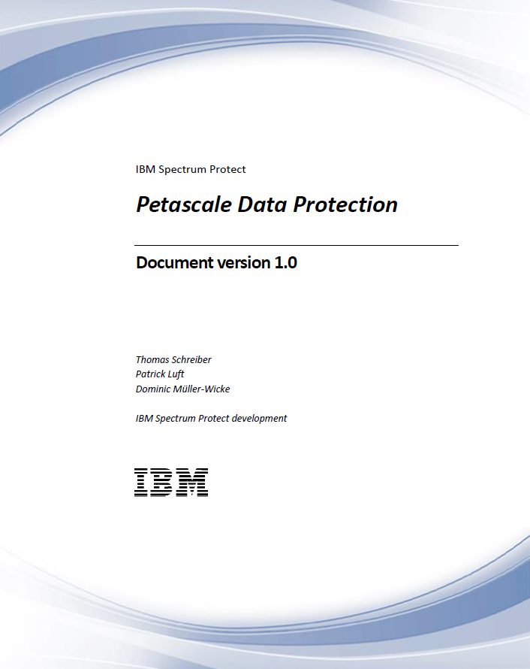
Petascale Data Protection
The singificant growth of data faces storage providers with new challanges. Beside the administration and maintenance of disk pools for large file systems the data protection and data archiving of big data clusters causes serious demands. The following slides describe a solution for data protection for large scaling environments with IBM Spectrum Protect and IBM Spectrum Scale.
This slide deck corresponds to the whitepaper „Peta Scale Data Protection“
Link to the paper: https://www.ibm.com/developerworks/community/wikis/home?lang=en#!/wiki/Tivoli%20Storage%20Manager/page/Petascale%20Data%20Protection
The paper describes a data protection approach scaling up to hundreds of petabytes for an IBM Spectrum Scale file systems using IBM Spectrum Protect backup-archive client and IBM Spectrum Protect for Space Management. The focus of this paper is to provide configuration guidance for the setup and operation of the data protection processes in such an environment.
This paper also introduces the concept of different service levels for data protection on file system and fileset level.

Slide 13
Peta Scale Data Protection – Technology
Key technology behind the solution is Spectrum Protect „active server binding“ that is implemented from Spectrum Protect for Space Management and used from Specturm Protect backup-archive client.
Usage of Spectrum Protect for Space Management (HSM) for file migration is optional, but file system management is required for active server binding. HSM is mandatory if fast disaster recovery with SOBAR is planned.
The first time a file will be send from file system to the Spectrum Protect server (backup or HSM) it will be bound to the specified server.
Granularity of backup and HSM processing is Spectrum Scale fileset level. The backup and HSM processing for each fileset is independent from others.
Active server binding is visible for Spectrum Scale policy engine scans
With a first backup FileN was bound to ServerA and can‘t be send to a different server now
Spectrum Protect
„active server binding“
FileN:ServerA
Spectrum Scale
cluster
Spectrum Protect backup-archive client,
Spectrum Protect for Space Management
Spectrum Protect
ServerA

Slide 14
Using IBM Spectrum scale as storage for
IBM Spectrum Protect

Slide 15
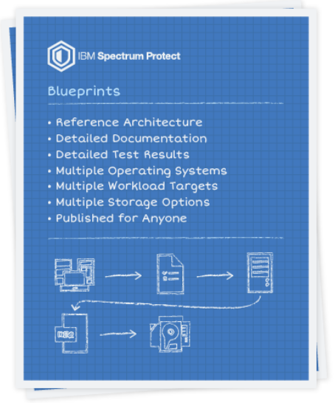
IBM Spectrum Protect™ Blueprints
Faster deployments saving time and money
What is it? Prescriptive hardware and build detail to handle defined workloads with build automation
  Designed around small, medium, or large workloads
  Server and storage references optimized for deduplication and disk-only environments
  Automated validation for hardware, file system, and operating system setup
  Automated configuration for IBM Spectrum Protect database, storage pool, policy, and schedules
  Platforms:
    Linux and Windows on Intel x86_64
    AIX on Power
    Linux on Power, big endian
  Storage
    Storwize V7000, V5000, V3700 (direction to replace with V5010)
    IBM Elastic Storage Server GL4, GL2 (powered by IBM Spectrum Scale)
Benefits Significantly improved time to value
Faster server deployments than ever before. Setup in as little as 3 hours.
Systematic design and build that aligns with software defined data protection
Reduced risk
  Automated best-practice configurations
  Less guesswork for performance optimization
on developerWorks: http://ibm.biz/IBMSpectrumProtectBlueprints
Notes:
1) Blueprints for designing SP servers given in three standard sizes that scale S,M,L
2) They implement disk-only SP solutions optimized for container pools with deduplication and replication
3) Reference architectures for servers and storage. OS’s include Linux and Windows for x86, AIX for Power, with Linux on power coming later this year (big endian)
4) Automation to speed deployment time

Slide 16
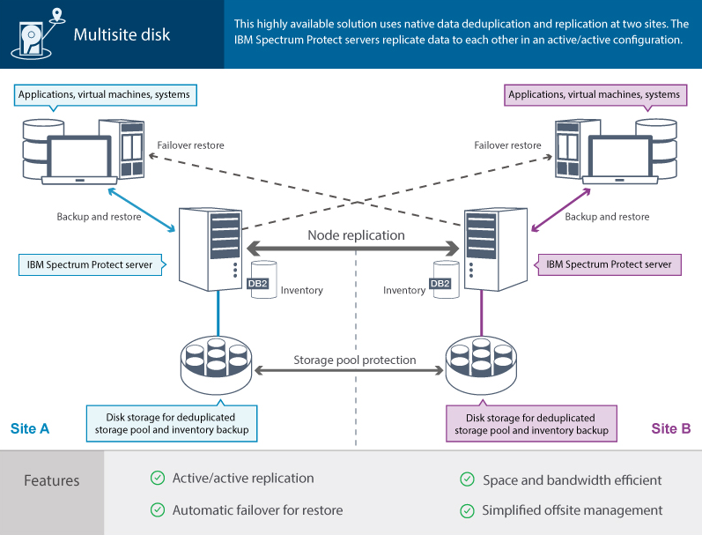
Disk-based backup solution with replication
Notes:
1) We are standardizing on 4 solutions for implementing Spectrum Protect
2) The single and multi-site disk solutions are the target design of the blueprint
3) Two blueprint systems can easily be connected to provide a disk-only solution which includes node replication.
4) Also a suitable design for HSM and Archive.

Slide 17
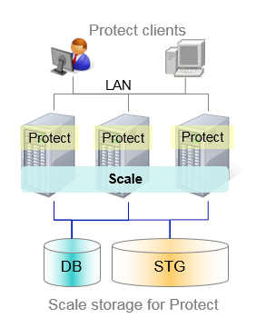
Spectrum Protect on Spectrum Scale - Overview
Multiple Spectrum Protect instances store DB and storage pools in a Spectrum Scale file system
  Scale provides a global name space for all Protect instances
  Protect instances share Scale file system resources
Protect instances run on Scale cluster nodes accessing the Scale file system and disk directly
Scale file systems balance the workload and capacity for all Protect instances on disk
Provides standardized, scalable and easy to use storage infrastructure for the multiple Protect instances
Notes:
Better storage utilization – multiple TSM server share the same storage
Better operational efficiency with one storage for all TSM server
Seamless scalability of storage capacity and performance
Highly scalable performance with intelligent striping across all disk devices
Disaster protection with TSM or GPFS replication or GPFS native RAID
Cost efficient by utilizing standard infrastructure components
High availability in clustered file system

Slide 18




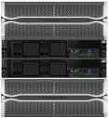
Deployment options
On Scale server
As Scale client
With Elastic Storage Server
Protect clients
Protect client
LAN
Protect client
LAN
LAN
Scale client
Protect servers
Scale client
Protect servers
Scale
Scale
Scale cluster
Protect servers
ESS server
Scale server
Protect server runs on Scale servers
Direct SAN storage access
Protect runs on Scale client connected to Scale / ESS NSD server
SAN or LAN access from Protect server to Scale / ESS server

Slide 19

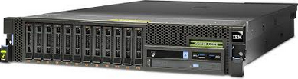
Blueprint configurations, IBM® POWER8™
IBM POWER8 System S822 based
Operating Systems
  AIX 7.1
  Power Linux (S822L)
small
medium
large
IBM POWER8 S822
1 x 10core p8 3.42Ghz
(6 cores used)
64 GB RAM
Dual port 8Gb FC
Dual port 10Gb Ethernet
1TB database
128GB active log
1TB archive log
45TB storage pool
IBM POWER8 S822
1 x 10core p8 3.42Ghz
128 GB RAM
Dual port 8Gb FC
Dual port 10Gb Ethernet
2TB database
128GB active log
3TB archive log
200TB storage pool
IBM POWER8 S822
2 x 10core p8 3.42Ghz
256 GB RAM
2 x Dual port 8Gb FC
2 x Dual port 10Gb Ethernet
6TB database
256GB active log
4TB archive log
1PB storage pool
Notes:
1) IBM Power models based on all based on power 8 S822 model (AIX or Power Linux)
2) pLinux uses S822L
3) CPU cores and memory scale up S,M,L

Slide 20

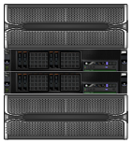
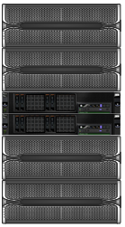

IBM Elastic Storage Server configurations
medium
large
With IBM Spectrum Scale™
software
IBM Elastic Storage Server is a bundled hardware, software, and services offering that provides:
A scalable, fast, and low-cost software defined storage platform
Dense JBOD expansions (4U x 60, 3.5” disks)
IBM Spectrum Scale RAID (GPFS native raid)
    Data and redundancy info distributed across all disks in the JBOD
    Array sizes not limited to spindle counts
    Very fast rebuild times for failed drives
IBM ESS GL-2
2 enclosures, 12u
116 x 6TB NL-SAS (stgpool, archlog, db backup)
2 x SSD caching disks
10GbE, 40GbE, or Infiniband
430 TB usable
IBM ESS GL-4
4 enclosures, 20u
232 x 6TB NL-SAS (stgpool, archlog, db backup)
2 x SSD caching disks
10GbE, 40GbE, or Infiniband
900 TB usable
5146 Machine Type
1818-80E DCS3700 Expansion Chassis
2TB, 4TB, or 6TB NL-SAS Drives
Note: SSD or Flash for the database is required from another storage system such as the IBM Flash System, PCI Flash adapter, or SSD’s in internal server drive bays
Notes:
1) ESS is a bundled solution built upon IBM Spectrum Scale
2) Scale Raid provides very scalable and high performing disk solution ideally suited to SP stgpool workload
3) ESS GL-2 and GL-4 models
4) Very dense expansions with 60 NL-SAS drives per 4U expansion
5) NOTE: another storage location providing SSD/flash is needed for the TSM DB!

Slide 21
Protect + ESS blueprint design
The blueprint configuration script automates Protect server deployment with ESS
ESS used for storage pool, archive log, database backup copies, and instance home directory files
SSD/Flash external to ESS used to hold the Protect database and active log
Simplified directory layout with sub-directories under a single Scale file system
  Storage pool does not require many separate file systems as is the case with Storwize blueprint
Protect server options DIRECTIO and DIOENABLED turned off to maximize throughput with Scale
ESS file system configuration:
  6TB NL-SAS drives in the GL-4 provide ~900TB usable capacity
  ESS file system for Protect storage pool created using 8+2p RAID code and 2MB block size
    Recent testing shows improvement with GL-6 and larger 8MB block size
  3WayReplication raid code used for metadata and 256K block size
  Only 1 TB reserved for metadata due to container storage pool creating a relatively small number of large files
  Client-side Scale cache increased on the Protect server to 24 GB

Slide 22
Protect + ESS configuration details
ESS is configured with an existing Scale cluster that is ready to use via a service offering
On the IBM Spectrum Protect server:
  Install IBM Spectrum Scale and IBM Spectrum Protect software
  On Linux, prepare the Scale kernel portability
  cd /usr/lpp/mmfs/src
  make Autoconfig
  make World
  make InstallImages
  mmstartup
  Setup passwordless ssh between the ESS storage and management nodes and the IBM Spectrum Protect server
  Add the Spectrum Protect server as a node in the existing cluster (from one of the storage nodes)
  mmaddnode -N 192.0.2.7
  Tune Spectrum Scale for the container pool workload on the Spectrum Protect server node
  mmchconfig disableDIO=yes,aioSyncDelay=10,pagepool=24G -N server_ip_address

Slide 23
Protect + ESS configuration details (continued)
Create the Spectrum Scale file system
  Create a stanza file to use for vdisk, nsd, and file system creation
  # cat /tmp/ess_vdisk
  %vdisk: vdiskName=GL2_A_L_meta_2m_1 rg=GL2_A_L da=DA1 blocksize=256k
  size=500g raidCode=3WayReplication diskUsage=metadataOnly pool=system
  %vdisk: vdiskName=GL2_A_R_meta_2m_1 rg=GL2_A_R da=DA1 blocksize=256k
  size=500g raidCode=3WayReplication diskUsage=metadataOnly pool=system
  %vdisk: vdiskName=GL2_A_L_data_2m_1 rg=GL2_A_L da=DA1 blocksize=2m
  raidCode=8+2p diskUsage=dataOnly pool=data
  %vdisk: vdiskName=GL2_A_R_data_2m_1 rg=GL2_A_R da=DA1 blocksize=2m
  raidCode=8+2p diskUsage=dataOnly pool=data
  Create NSD disks using the stanza file
  mmcrvdisk-F /tmp/ess_vdisk
  mmcrnsd -F /tmp/ess_vdisk
  Create and mount the file system
  mmcrfs esstsm1 -F /tmp/ess_vdisk -D nfs4 -B 2m --metadata-block-size 256k
  -A yes -L 128M -k nfs4 -m 1 -M 2 -Q no -r 1 -R 2 -S relatime -T /esstsm1 -z no
  mmmount /esstsm1
Notes:
Caution: the stanza file is modified by the intermediate steps, so create a backup copy before starting
The number of data vdisks to create depends on the available capacity. The stanza example shown does not define the size= parameter for the data disks, so they will take all available space in the recovery groups.
With larger ESS sizes, we recommend creating creating enough vdisks such that the size of any single vdisk does not exceed 50TB.
With recent testing on a GL-6, sequential write throughput improve by increasing the data vdisk and file system block size up to 8MB.

Slide 24
Protect + ESS configuration details (continued)
Edit the blueprint configuration response file
cat responsefile_ess.txt
serverscale L
db2user tsminst1
db2userpw passw0rd
db2userhomedir /esstsm1/tsminst1/tsminst1
db2group tsmsrvrs
instdirmountpoint /esstsm1/tsminst1
dbdirpaths /ssd/tsminst1/database/db01,/ssd/tsminst1/database/db02
actlogpath /ssd/tsminst1/database/alog
tsmstgpaths /esstsm1/tsminst1/deduppool
archlogpath /esstsm1/tsminst1/database/archlog
dbbackdirpaths /esstsm1/tsminst1/dbback
backupstarttime 02:00
tsmsysadminid admin
tsmsysadminpw passw0rd
tcpport 1500
servername CLIENT21
Run the blueprint configuration script using the response file
perl TSMserverconfig.pl responsefile_ess.txt
Run the blueprint configuration script
perl TSMserverconfig.pl responsefile_ess.txt
Notes:
Although the configuration script can be run interactively, easiest to use the response file.
Note: path to SSD for the database volumes and the active log

Slide 25
References
IBM Knowledge Center
IBM Spectrum Scale: http://www.ibm.com/support/knowledgecenter/STXKQY/ibmspectrumscale_welcome.html
IBM Spectrum Protect: http://www.ibm.com/support/knowledgecenter/SSGSG7/landing/welcome_ssgsg7.html
IBM Spectrum Protect blueprints
http://ibm.biz/IBMSpectrumProtectBlueprints
Petascale Data Protection
https://www.ibm.com/developerworks/community/wikis/home?lang=en#!/wiki/Tivoli%20Storage%20Manager/page/Petascale%20Data%20Protection
Overview on Spectrum Protect – Spectrum Scale Integration
https://www.ibm.com/developerworks/community/wikis/home/wiki/Tivoli%20Storage%20Manager/page/Integrating%20IBM%20Tivoli%20Storage%20Manager%20with%20IBM%20Elastic%20Storage
Configuration of Spectrum Protect for Spectrum Scale AFM
https://www.ibm.com/developerworks/community/wikis/home/wiki/Tivoli%20Storage%20Manager/page/Configuring%20IBM%20Spectrum%20Scale%20Active%20File%20Management
Spectrum Protect for Space Manangement whitepaper
Setup policy driven threshold migration: http://www.ibm.com/support/docview.wss?uid=swg27018848
Setup cross platform cluster: http://www.ibm.com/support/docview.wss?uid=swg27028178
YouTube
IBM Spectrum Protect - mmbackup general functions https://youtu.be/3PMO4Sdegs0
IBM Spectrum Protect - mmbackup tweaks for max performance https://youtu.be/sg4FrZHi99Y
IBM Spectrum Protect using Scale for db, logs & storage pools https://youtu.be/vIobC2MDIlE

Slide 26
Thank you

