Slide 1
Lisa Gerhardt
Data & Analytics Group, NERSC
Data Management Framework at NERSC

Slide 2
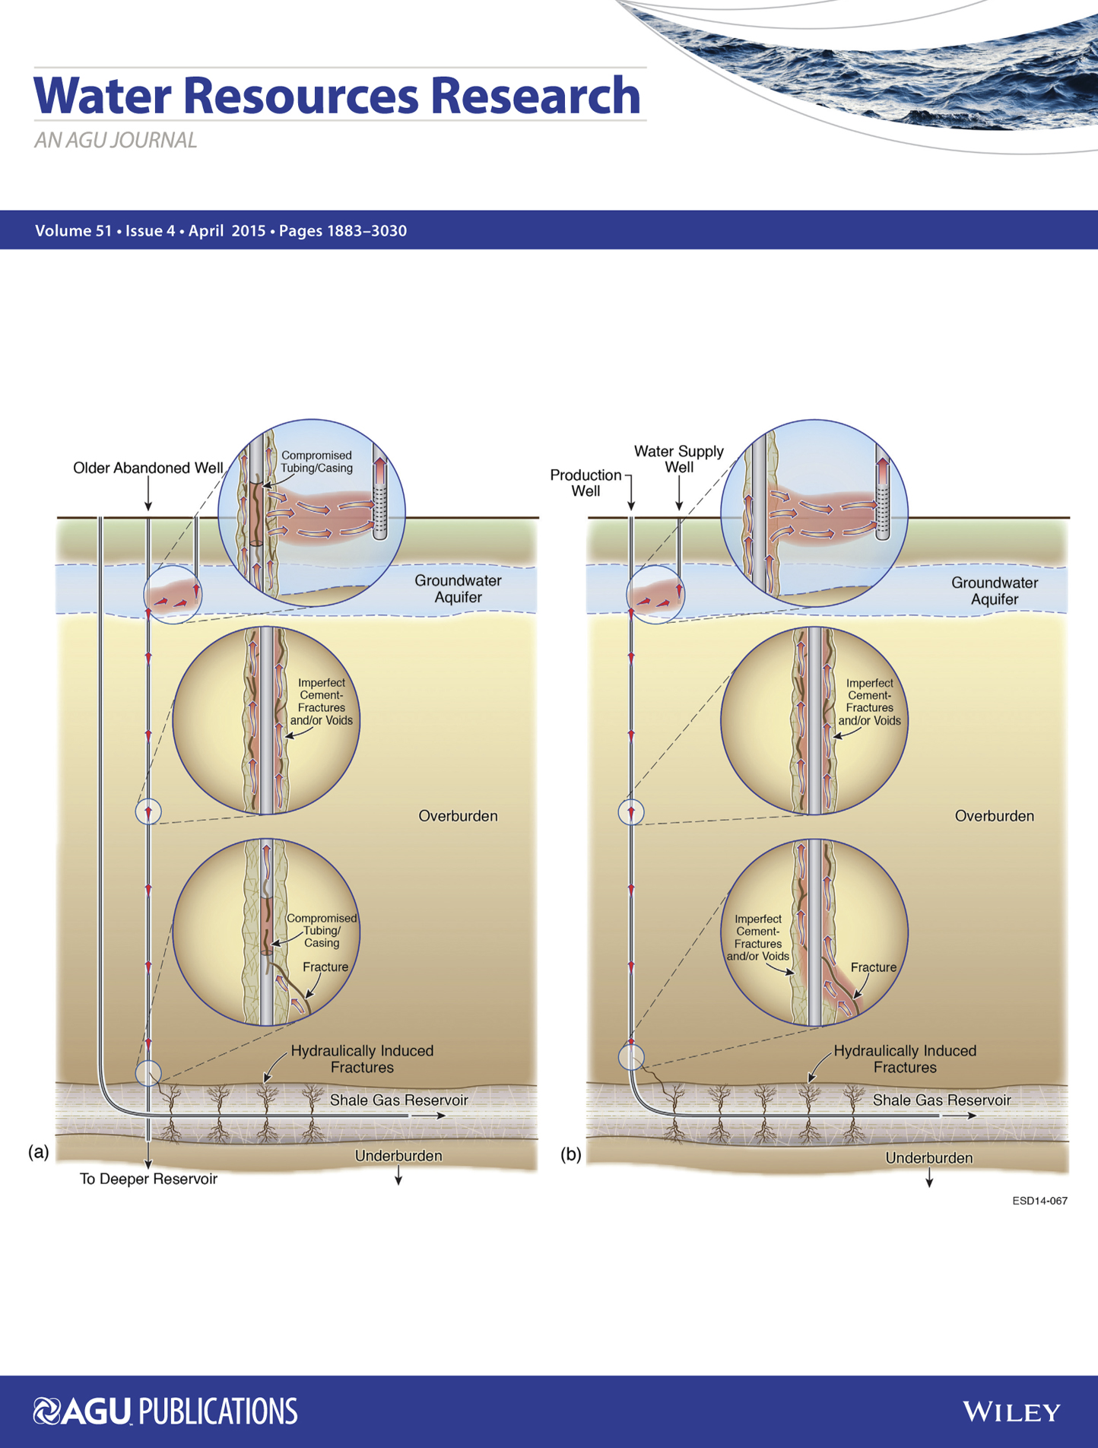





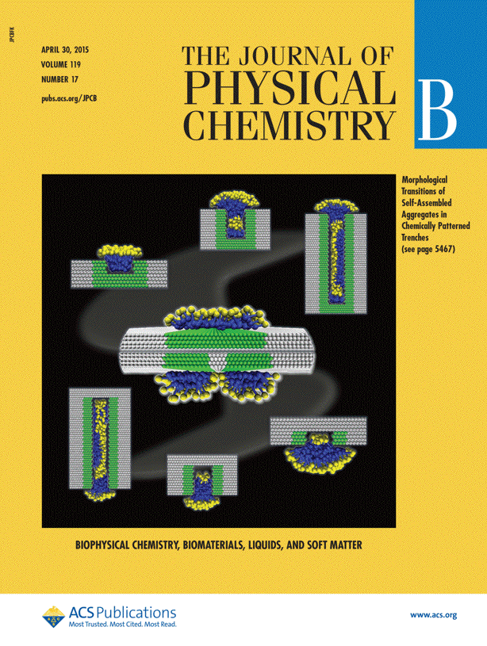
Focus on Science
NERSC supports the broad mission needs of the six DOE Office of Science program offices
6,000 users and 750 projects
2,078 referred publications in 2015
2015 Nobel prize in physics supported by NERSC systems and archive

Slide 3
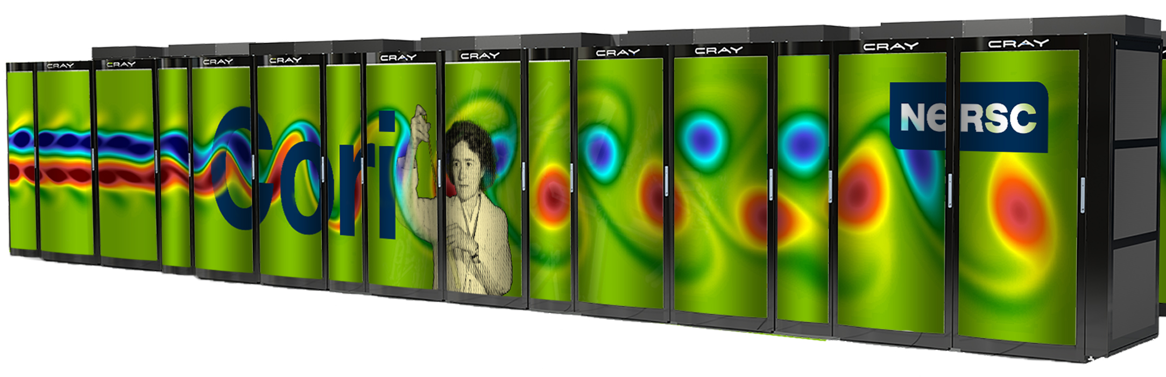

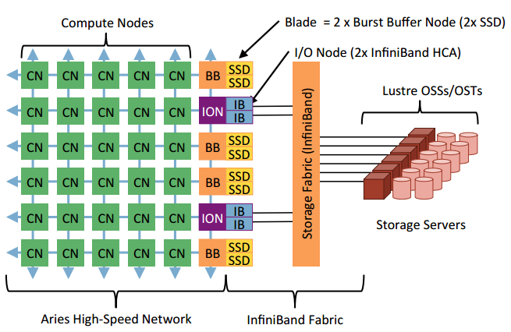
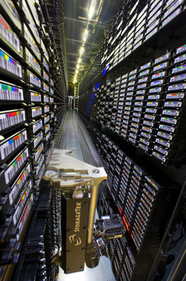
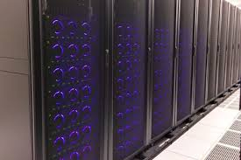
NERSC Resources at a Glance
Cori: 30PFs,
28PB Lustre File System
700 GB/s agg BW
Edison: ~3PFs,
8PB Lustre File System
150 GB / s agg BW
Burst Buffer: 1.8PB NVRAM DataWarp File System
1.8TB/s agg BW
7PB Spectrum Scale File System
20TB/project and buy-in model
150 GB /s agg BW
HPSS Archive: ~100 PBs
Front end disk cache sized to hold 30 days of data

Slide 4
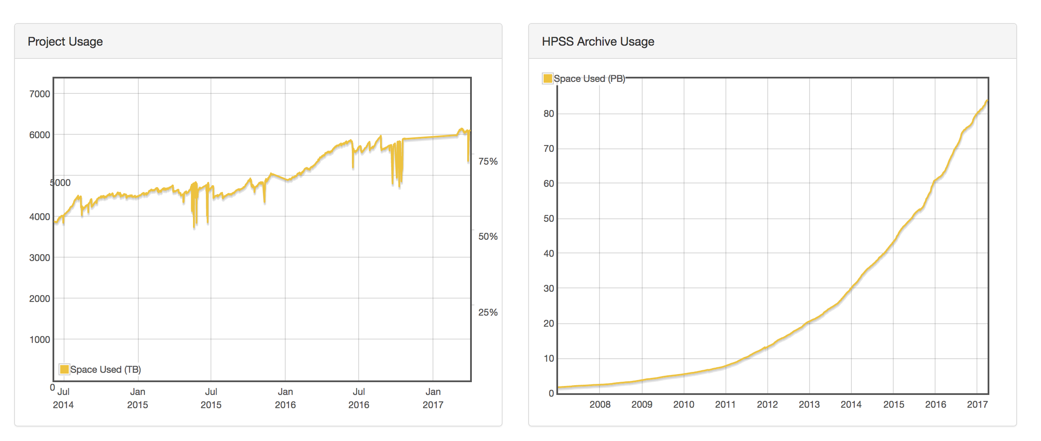
Data Workloads Are Significant at NERSC
More than 1/3 of projects at NERSC involve the analysis / simulation of experimental or observational data from detectors or other apparatus
Moving and managing data is consuming a larger and larger fraction of scientists time. Common issues across groups at NERSC:
  Finding files and understanding data
  Moving data
  Triggering workflows
Notes:
Is the primary role of this project to:
Analyze data from experiments/ observational facilities; OR
Create tools and algorithms for analyzing exp/obs data; OR
Combining models and simulations with exp/obs data?

Slide 5
Data Lifecycle at NERSC
Lively file system
  Scratch has 13 PB of data and 1.2B inodes. Average 18M files modified and 0.4 PB of data read per day
  Project has 6PB and 880M inodes. Average fluctuation in number of inodes is 1M and 7 TB of data deleted or created per day
  HPSS increases by ~30TB / day
Only traditional Linux tools
  “ls”, “find”, and “du” to see usage
  All movement between tiers is manual: “cp”, “mv”, “hsi put”, “htar”
Scratch / BB
Project
HPSS
Notes:
Add some pretty pictures?

Slide 6
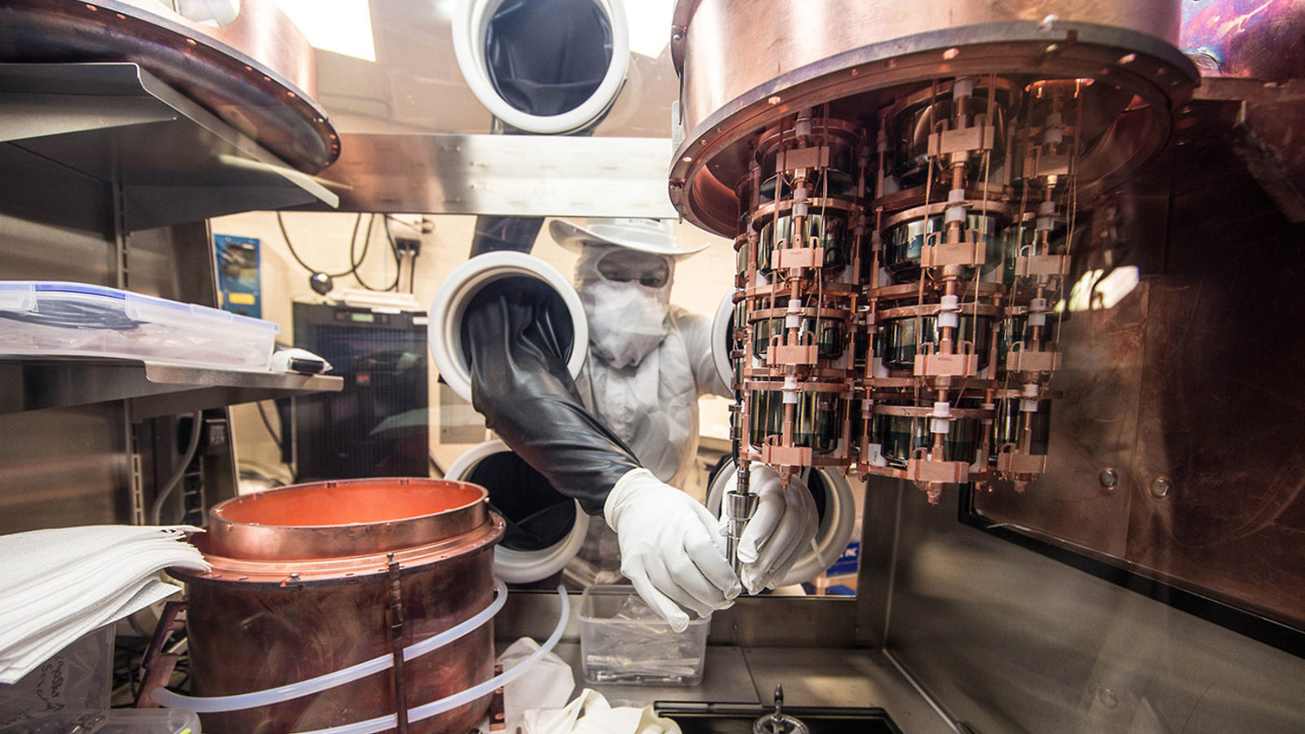
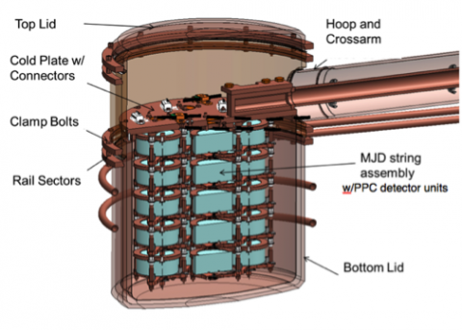
Data Store Example: Majorana
100 TB on project, 200 TB in HPSS
Data Mirror at NERSC
  Files are aggregated by month and put into HPSS, but sometimes there are stragglers
Project directory shared among 60 users
  Frequently hit their quota and see permissions drift

Slide 7
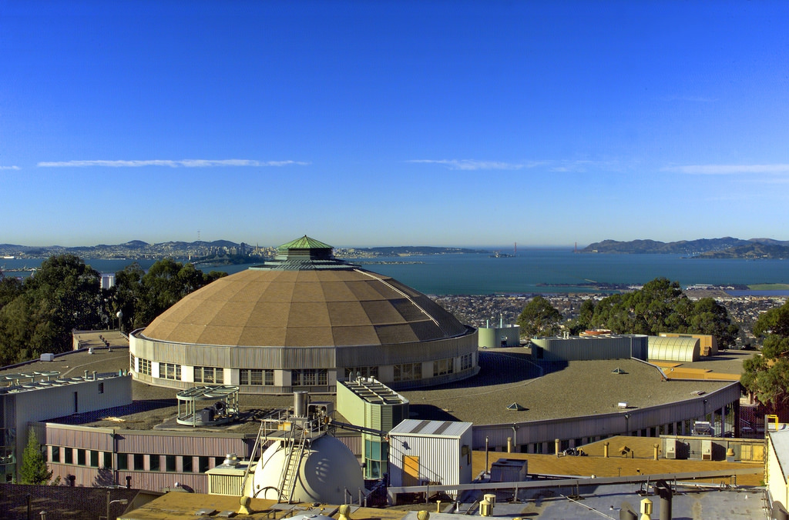
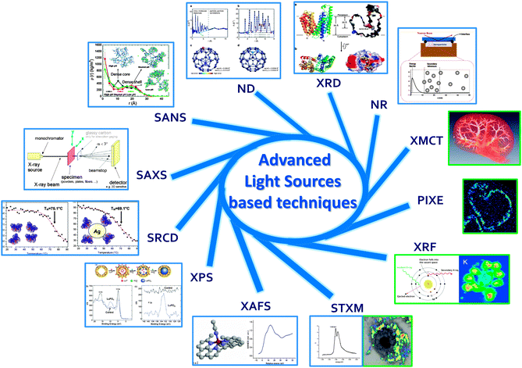
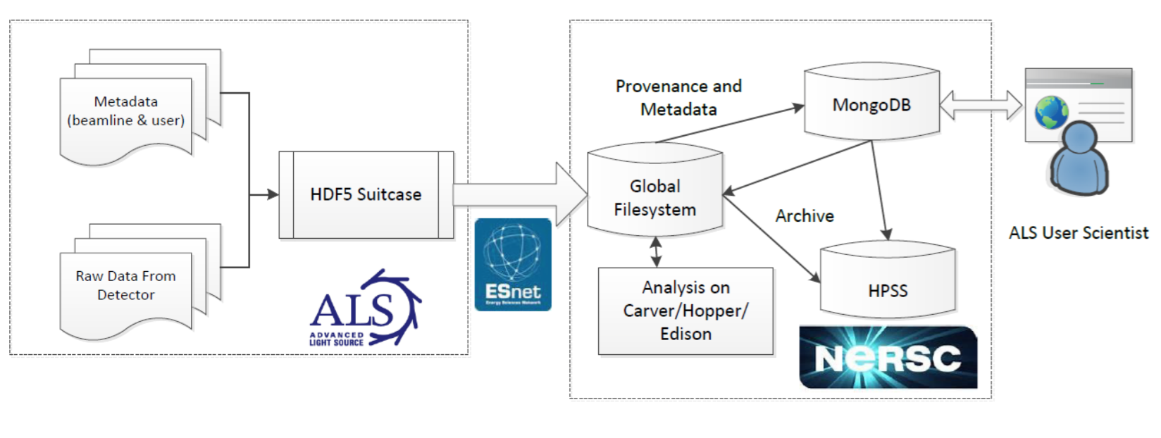
Data Flow Example: ALS
Serves 1000s of users. Produces TB / day.
450 TB of space on project
1 PB in HPSS
Analysis on
Cori / Edison
Diagram from Deslippe et al. “Workflow Management for Real-time Analysis of Lightsource Experiments”, 2014 9th Workshop on Workflows in Support of Large-Scale Science (WORKS), 2014

Slide 8
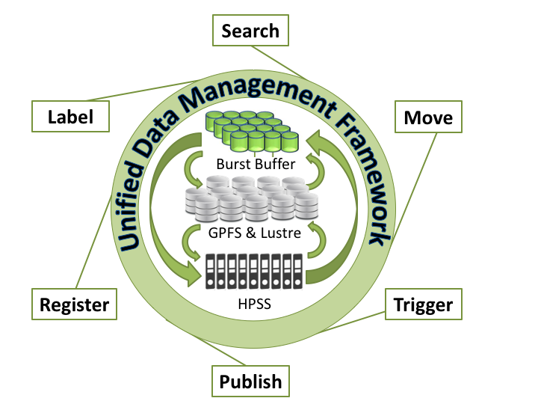
Data Management Framework at NERSC
Intended to address user issues with
  Search and Discovery
  Movement
  Workflows
  Metadata Tracking
Without
  Impacting FS performance
  Forcing users into 3rd party software
Leverage existing FS tools and design modularly
  ILM, Robinhood, GHI
  Able to adjust to new layers (like BB)

Slide 9
First Step: Data Dashboard
Serve as central UI point for all other tools
Addresses common issue of shared project space hitting quota
Fed by daily Spectrum Scale scans generated by ILM Policy Engine
  6PB project file system takes about 4 hours to scan
Output 880M line 200GB text file
Parse with Spark to generate aggregates by user
  Takes <5 minutes on 16 nodes
Use D3 Javascript library to render visualizations of file system usage
Entire process from scan to display takes a few hours, refreshes daily

Slide 10
Data Dashboard: Live Demo
https://portal-auth.nersc.gov/project/mpccc/agreiner/mynersc-dev/live/data-mgt.php

Slide 11
Data Dashboard: Next Steps
Expand to Lustre and HPSS file systems
  Challenging because Lustre tools cannot keep up with file system usage and can cause file system outages
  HPSS DB not designed for high speed dumps of information
Add tools for project leads to fix drifted permissions
  Trigger ILM policies
Enable functionality for users to “walk” and search across the file system
  UI and framework design underway now for project file system
Central hub for other tools

Slide 12
Data Framework: Future Plans
Data Mover
  Goal: Automate movement between the tiers
    Detect when new file has appeared or meets some criteria (like unread for 6 months)
    Copy (or move) file to another file system
    Notify user when it has completed
  Leverage AFM and Robinhood to move data between tiers
    Write scripts to for tools to invoke when moving data between file systems
  Working on test implementation of Spectrum Scale / HPSS integration (GHI)
    Needs careful deployment and limitation to avoid issues with both file systems
    Could address many of the needs of experimental groups at NERSC

Slide 13
Data Framework: Future Plans
Workflow support
  Many complicated pipelines rely on the appearance of data to trigger
  Now: use crons and find to trigger
  Future:
    Use data dashboard tools to detect appearance of files
    Extend ILM and Robinhood script hooks to run user created scripts to update DBs, calc. checksums, archive data, send emails, etc.
Metadata support
  Leverage Spectrum Scale and HPSS extended attributes to embed user-created metadata into the data

Slide 14
Conclusion
NERSC is working on a framework to address many of user’s data management challenges
Still in the early stages, if you’re interested in collaborating, please let me know
Data volumes will only increase, so developing data management tools will be critical in the exabyte and exascale age

Slide 15
NERSC Data Management Group
Lisa Gerhardt, Annette Greiner, Damian Hazen, Rei Lee, Kirill Lozinskiy, Bhupender Thakur, Jeff Porter, Wayne Hurlbert, Dave Paul, Oliver Ruebel, Deborah Bard

Slide 16
National Energy Research Scientific Computing Center

Slide 17
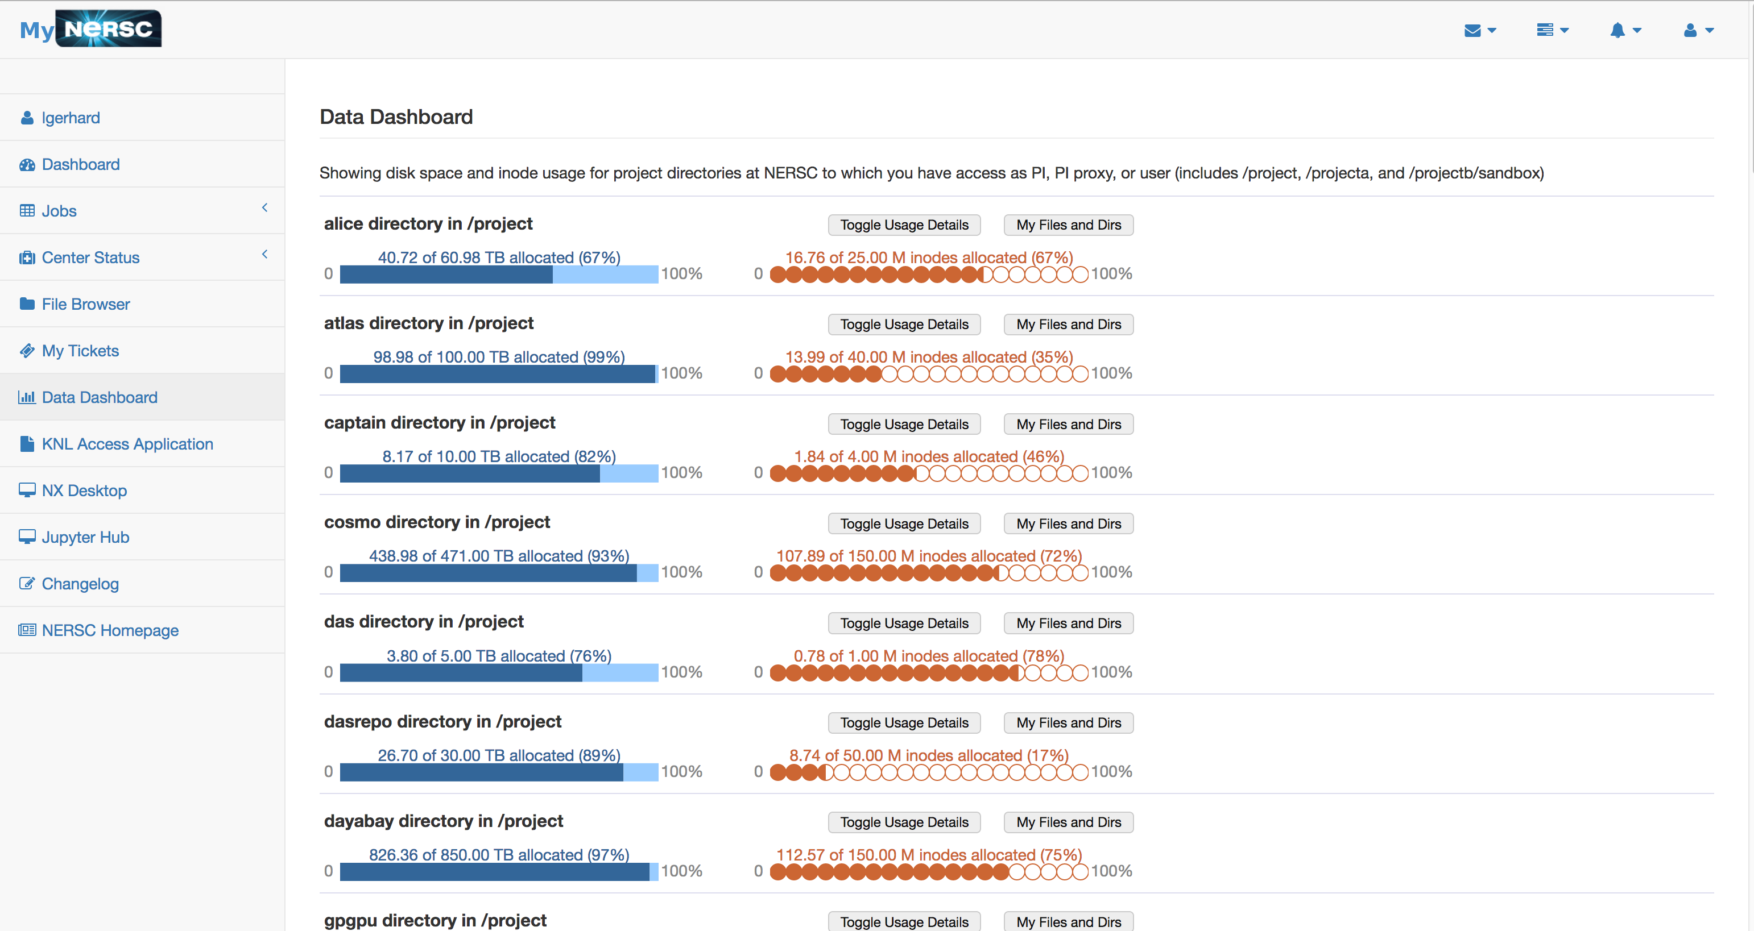

Slide 18
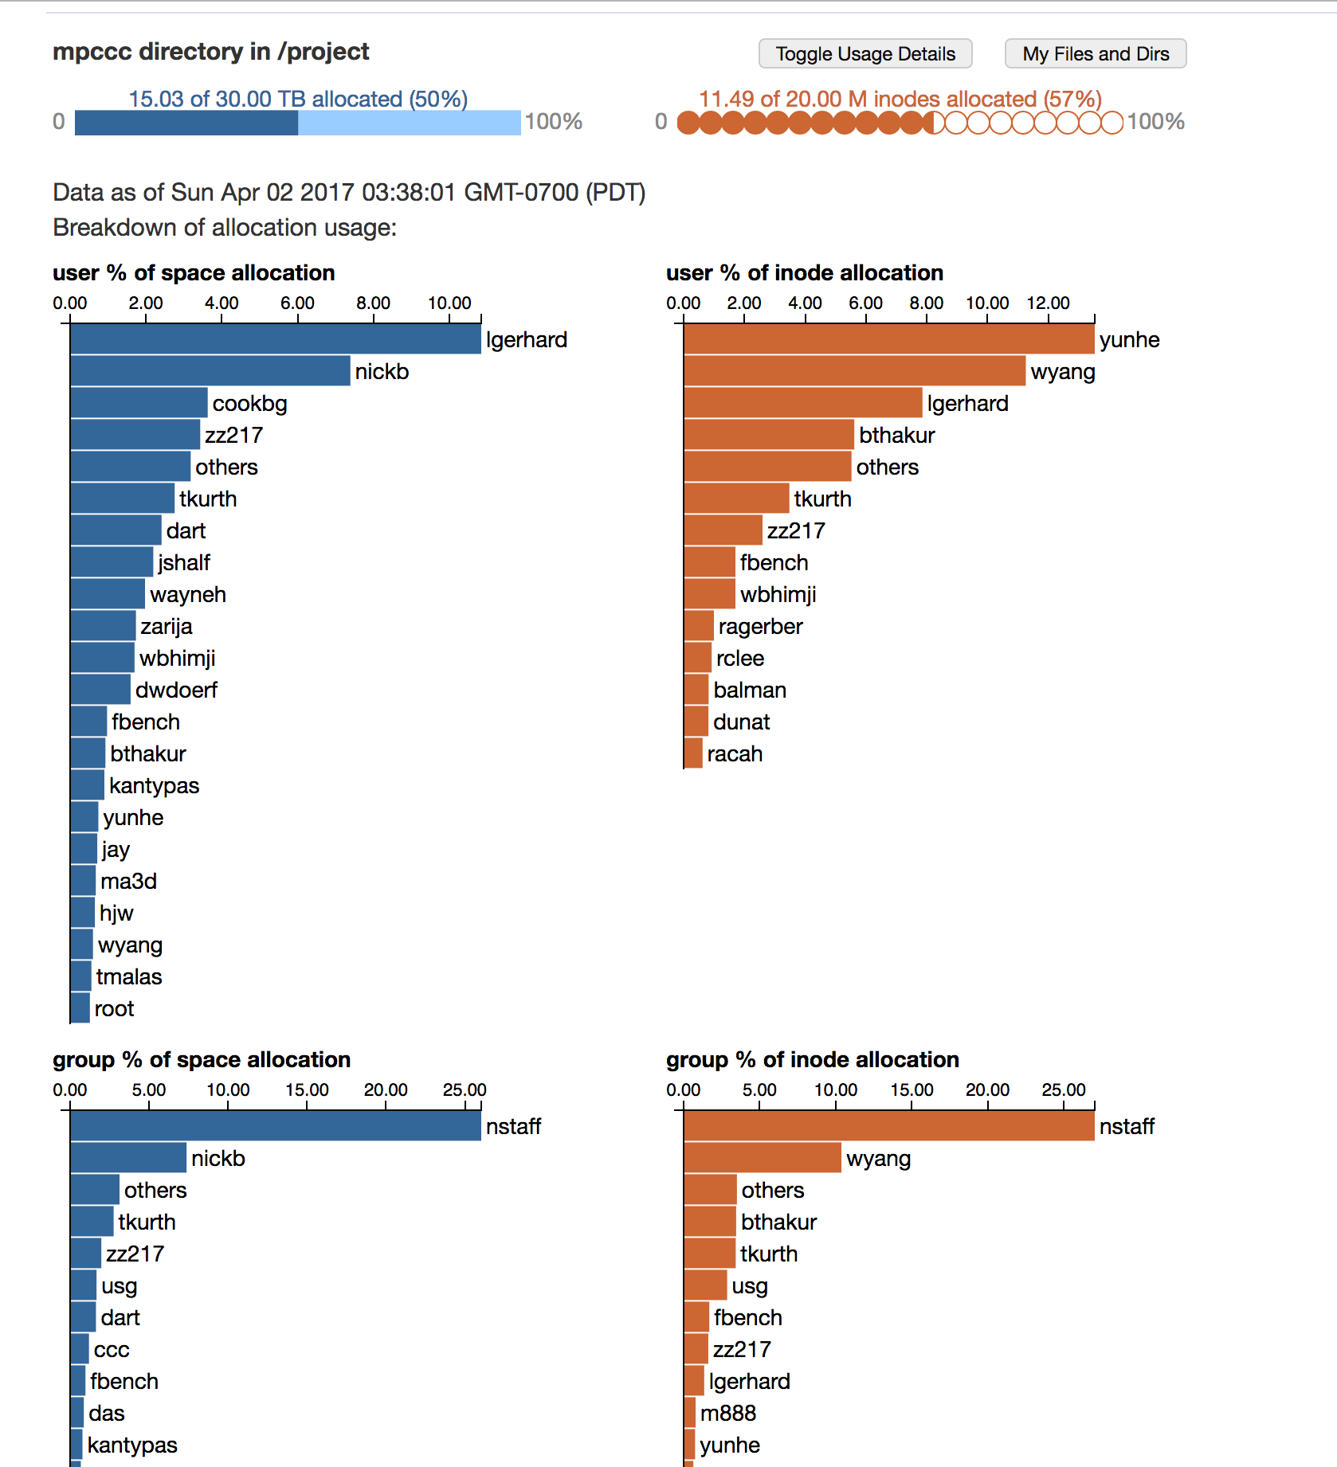

Slide 19
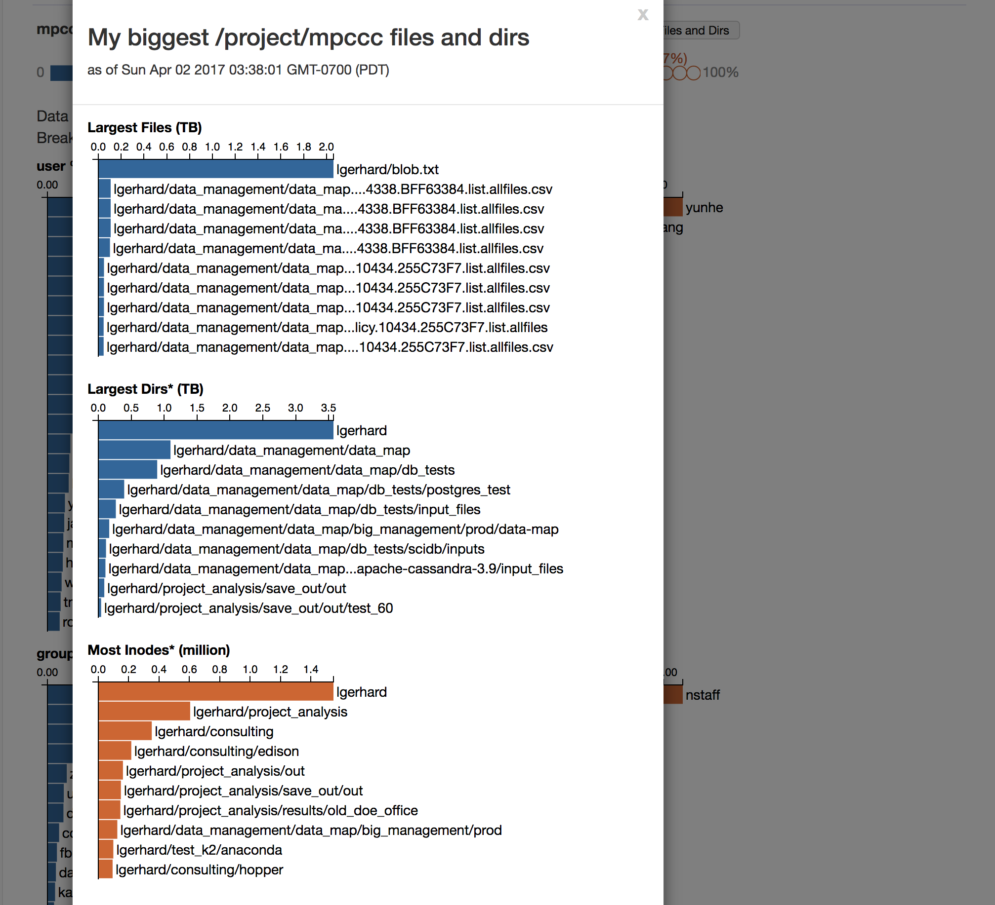

Slide 20
Different FS for different uses
Lustre “scratch” and Burst Buffer
  Ephemeral storage, data purged if not accessed, user-based quotas and permissions
  Intended for active data used for running computations
Spectrum scale “project” file system
  Medium term storage, data never purged, group quota and permissions (each science group has a separate fileset)
  Intended for shared data needed by entire science group, will be used for computing in the near future
HPSS Tape Archive
  Long term storage, data never purged, user-based and group quotas and permissions
  Intended for permanent archival of scientific data

