Slide 1


Catching rogue jobs before they overload shared storage
Dr Rosemary Francis, CEO and Co-founder
The I/O Profiling Company - Protect. Balance. Optimise.
www.ellexus.com

Slide 2
Who we are
Ellexus is the I/O profiling company.
The company was founded to solve I/O and dependency problems for semiconductor design flows, but we now work across the HPC space in life sciences, cancer research, automotive, oil and gas etc.
Our latest tool Mistral has been developed with ARM to protect shared storage from bad data access patterns on large compute clusters.
Notes:
The company was founded 7 years ago to solve problems with IT infrastructure in the chip design industry, but we now work across HPC in industry and academia with customers such as Cancer Research UK.
We developed our new tool Mistral with ARM in order to solve storage issue they were having and that’s what I’m going to talk about today.

Slide 3
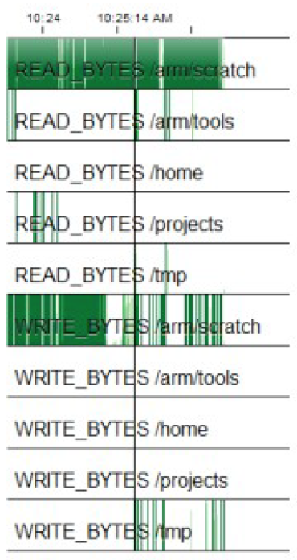
Mistral:
Solving the noisy neighbour problem
In a compute cluster it is possible for a small number of jobs to overload the shared file system. Example of a rogue job from ARM:
Lots of data is written to remote storage (/scratch).
But almost nothing is written to local storage (/tmp).
Notes:
This is a profile we made with Breeze at ARM and it highlights the problem that inspired the design of Mistral.
It’s very easy to overload shared storage with bad I/O. This job is supposed to use local storage for temporary jobs, but it’s been misconfigured by Mistral.

Slide 4
Mistral:
Protecting you against rogue jobs
Hotspots in your cluster can be caused by different types of I/O:
Too much data
A user accidentally
submitted 1,000 jobs with the debug flag left on.
They generated too
much data and crashed
the file system.
Millions of meta data
operations
One user wrote:
for (…) {
open()
write()
close()
}
This crashed the meta
data server.
Too many small files
One user accidentally
created a million zero-length files.
The file system crashed
when they were created
and then again when
they were deleted.
Notes:
Here are some other problems that we’ve seen.
The first is an example of a file system crashing under the volume of data written. A user brought down the file system three times in a week by leaving a debug flag on.
The next is a problem we first saw with a life sciences customer, but we’ve seen the same problem to some extent in every HPC industry. They crashed their meta data server by putting open-write-close in a for loop. It’s really easy to do in complex code and really hard to detect without I/O profiling.
These are all disaster scenarios, but we also see the same problems bringing down the performance of the file system even if they don’t crash it completely.
The third example is another one we’ve seen a lot, particularly in oil and gas and life sciences. Users often create millions of small files without understanding the consequences. This can cause problems when they are created, when they are deleted and it can cause problems for the backup and archive systems.

Slide 5
Mistral
Protect your storage from bad I/O patterns and rogue jobs.
Load balance your storage for good quality of service.
Optimise your applications for the storage and your infrastructure for your jobs.
Mistral: wide-scale I/O profiling and load balancing for shared storage
www.ellexus.com
Notes:
These are the goals we put together with ARM in order to solve the problem. We wanted to protect the storage from rogue jobs, load balance the storage to maintain reliable performance and to give them the information they needed to optimise the application for the storage and the storage for the applications.

Slide 6
Mistral:
How does it work?
Mistral sits at the application level.
The technology wraps every job and intercepts or controls all I/O calls.
Mistral is launched with the job directly or via the scheduler. This can be invisible to users.
> mistral mycommand.sh
Mistral
Mistral
Mistral
Mistral
Job
Job
Job
Job
Storage
Notes:
Mistral is very different from other storage analytics tools because it runs at the application level and it can run all the time on your whole cluster. You can integrate it with your scheduler in order to wrap up every job and be invisible to users or you can launch it directly as shown by wrapping up just one command.

Slide 7
Mistral:
How does it work?
Mistral
Mistral
If a job carries out too much I/O Mistral will generate an alert.
Mistral
Mistral
Job
Job
Job
Job
Job 42
exceeded 500MB/s
to /share/scratch
Storage
Notes:
Most of the time Mistral is silent, but when a job goes over an I/O limit that is set by you then Mistral will generate an alert. Here it’s telling me that job 42 has exceeded 500mb/s
It’s a very simple interface, but very powerful when used to identify rogue jobs and bad I/O patterns.

Slide 8
Mistral:
Advanced systems management
Use I/O data from Mistral to:
Identify I/O hotspots and rogue jobs
Locate bad I/O patterns
Educate users
I/O
Jobs
Notes:
The idea is to use Mistral to identify rogue jobs, but also track what is running on your cluster over time. Educate users by giving them I/O reports and by detecting problem applications or problem users.

Slide 9
Mistral:
Advanced systems management
Use I/O data from Mistral to:
Identify I/O hotspots and rogue jobs
Locate bad I/O patterns
Educate users
I/O
Jobs
Use Mistral I/O throttling controls to:
Improve quality of service
Load balance shared storage
I/O
Jobs
Notes:
Mistral doesn’t just monitor, Mistral can also throttle I/O. This means that you don’t have to react to a problem by killing jobs, you can load balance the storage by adjusting I/O limited for jobs and resolve the problem that way.

Slide 10
Customer case study: Catching rogue jobs
… stories from a Silicon Valley software startup
Notes:
Mistral is very different from other storage analytics tools because it runs at the application level and it can run all the time on your whole cluster. You can integrate it with your scheduler in order to wrap up every job and be invisible to users or you can launch it directly as shown by wrapping up just one command.

Slide 11
Customer case study: system architecture
Host-Leaf architecture
Host compute nodes:
Native Spectrum Scale
4 Gigabit/s Infiniband
32 Slots
Leaf compute nodes:
Send data over RCP to host nodes
Clustered NFS
Storage:
8 Spectrum Scale servers
Host
Leaf
Leaf
Leaf
Leaf
IBM Spectrum Scale
Notes:
Mistral is very different from other storage analytics tools because it runs at the application level and it can run all the time on your whole cluster. You can integrate it with your scheduler in order to wrap up every job and be invisible to users or you can launch it directly as shown by wrapping up just one command.

Slide 12
Customer case study
Problem 1: Bad working practices
Host
Jobs sometimes write from the leaf nodes instead of from the host.
If they hammer a particular mount point that can overload one of the filers.
Leaf
Leaf
Leaf
Leaf
IBM Spectrum Scale
Notes:
Mistral is very different from other storage analytics tools because it runs at the application level and it can run all the time on your whole cluster. You can integrate it with your scheduler in order to wrap up every job and be invisible to users or you can launch it directly as shown by wrapping up just one command.

Slide 13
Customer case study
Problem 2: Debug flag left on
Host
Job is debugged on one core then handed over to run at scale
– debug flag left on accidentally.
This happens weekly.
Leaf
Leaf
Leaf
Leaf
IBM Spectrum Scale
Notes:
Mistral is very different from other storage analytics tools because it runs at the application level and it can run all the time on your whole cluster. You can integrate it with your scheduler in order to wrap up every job and be invisible to users or you can launch it directly as shown by wrapping up just one command.

Slide 14
Customer Case Study: Mistral deployment
Mistral
Production jobs are wrapped in Mistral via an LSF job starter.
Mistral generates an alert if:
Leaf nodes write to the file system
Host nodes write too much data
Two use cases:
My house is on fire
My house was on fire, but I missed it
Integration with RTM makes this possible.
Host
Mistral
Mistral
Mistral
Mistral
Leaf
Leaf
Leaf
Leaf
IBM Spectrum Scale
Notes:
Mistral is very different from other storage analytics tools because it runs at the application level and it can run all the time on your whole cluster. You can integrate it with your scheduler in order to wrap up every job and be invisible to users or you can launch it directly as shown by wrapping up just one command.

Slide 15
Example contracts
Example contract:
monitoringtimeframe,60s
NAME PATH/MOUNT POINT IO TYPE LIMIT
M1, /gpfs/, read, 500MB
M2, /gpfs/, write 500MB
M3, /gpfs/, create+delete, 2000
Example alert:
TIME | RULE | VIOLATION | PID | PROGRAM | FILE | JOB ID
17:30:05 17:30:05 17:30:06 | M1 M2 M3 | 643MB/60s, 505MB/60s, 7405/60s, | 2784, 2784, 2784, | /tools/bin, /tools/bin, /tools/bin, | /gpfs/tools/config, /gpfs/data/file01, /gpfs/data/set05, | 12 12 12
Notes:
This is an example contract and some example output. It’s be simplified for the slide, but it gives you the right idea. In the contract you set a time frame, in this case 60s and then a set of rules that monitor or throttle the I/O.
Each rule has a path so you can have different rules for different areas of the file system
We have two read bandwidth rules and one rule monitoring the number of open calls. You can set a variety of different meta data rules. You can also set latency rules that trigger when the latency of the file system goes over a certain level. You may notice that the read rules can be set to only apply to reads of a certain size. This let’s you monitor small reads and writes separately.
The output is very simple when looked at in raw form like this. You get a time stamp, the rule ID, how much I/O took place and information for the IT andmistrators and cluster users. The job ID is the scheduler ID. The PID, program and the last file to be accessed let’s users identify where in their job the problem came from.

Slide 16
Mistral RTM integration: Goals
  To provide LSF administrators with a way to profile applications prior to them being onboarded into the cluster.
  To provide at-a-glance monitoring exceptions delivered by the Mistral product.
  To integrate with RTM’s Fault Management framework so administrators can be notified when there is an event in progress.
  To provide users with the ability to review the storage profile of their applications and workflows to search for solutions to performance problems.
Notes:
Mistral is very different from other storage analytics tools because it runs at the application level and it can run all the time on your whole cluster. You can integrate it with your scheduler in order to wrap up every job and be invisible to users or you can launch it directly as shown by wrapping up just one command.

Slide 17
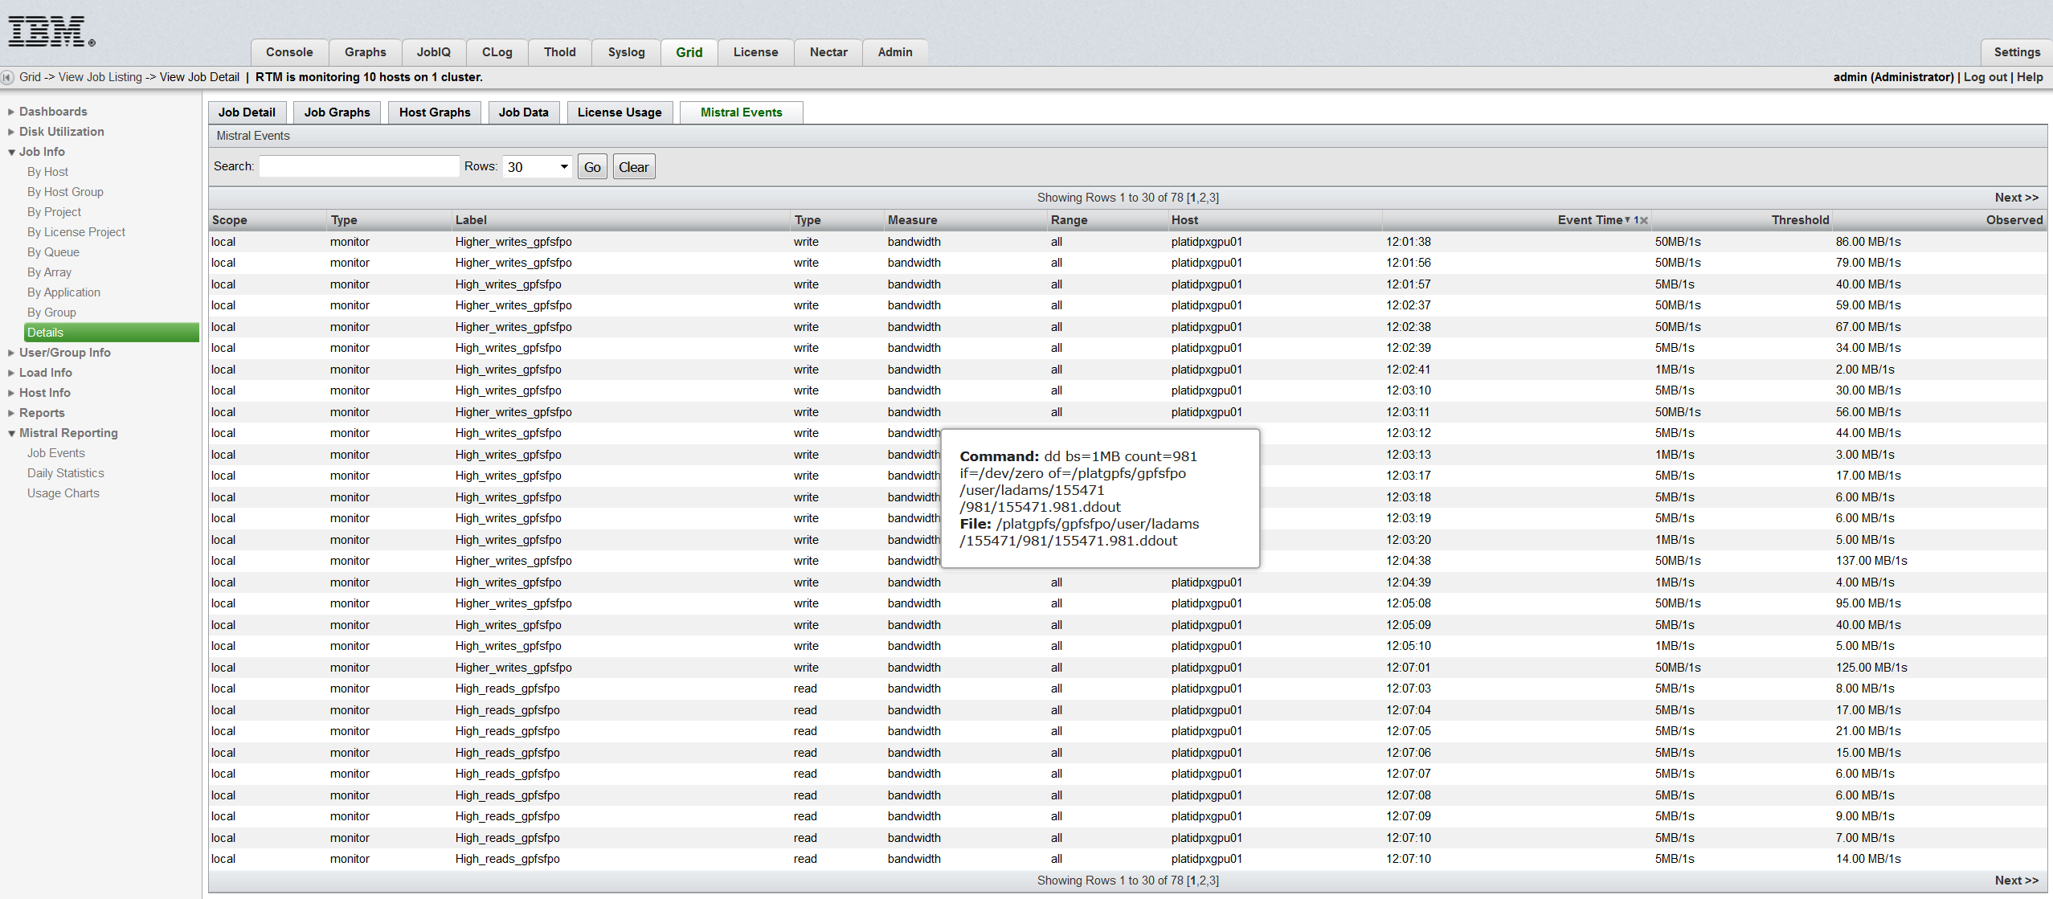
Mistral RTM integration: Per job events
Table showing:
Contract name
Contract type
Mistral I/O rule
I/O type
Measurement type
I/O size range
Event type
Threshold
Observed I/O
Notes:
Mistral is very different from other storage analytics tools because it runs at the application level and it can run all the time on your whole cluster. You can integrate it with your scheduler in order to wrap up every job and be invisible to users or you can launch it directly as shown by wrapping up just one command.

Slide 18
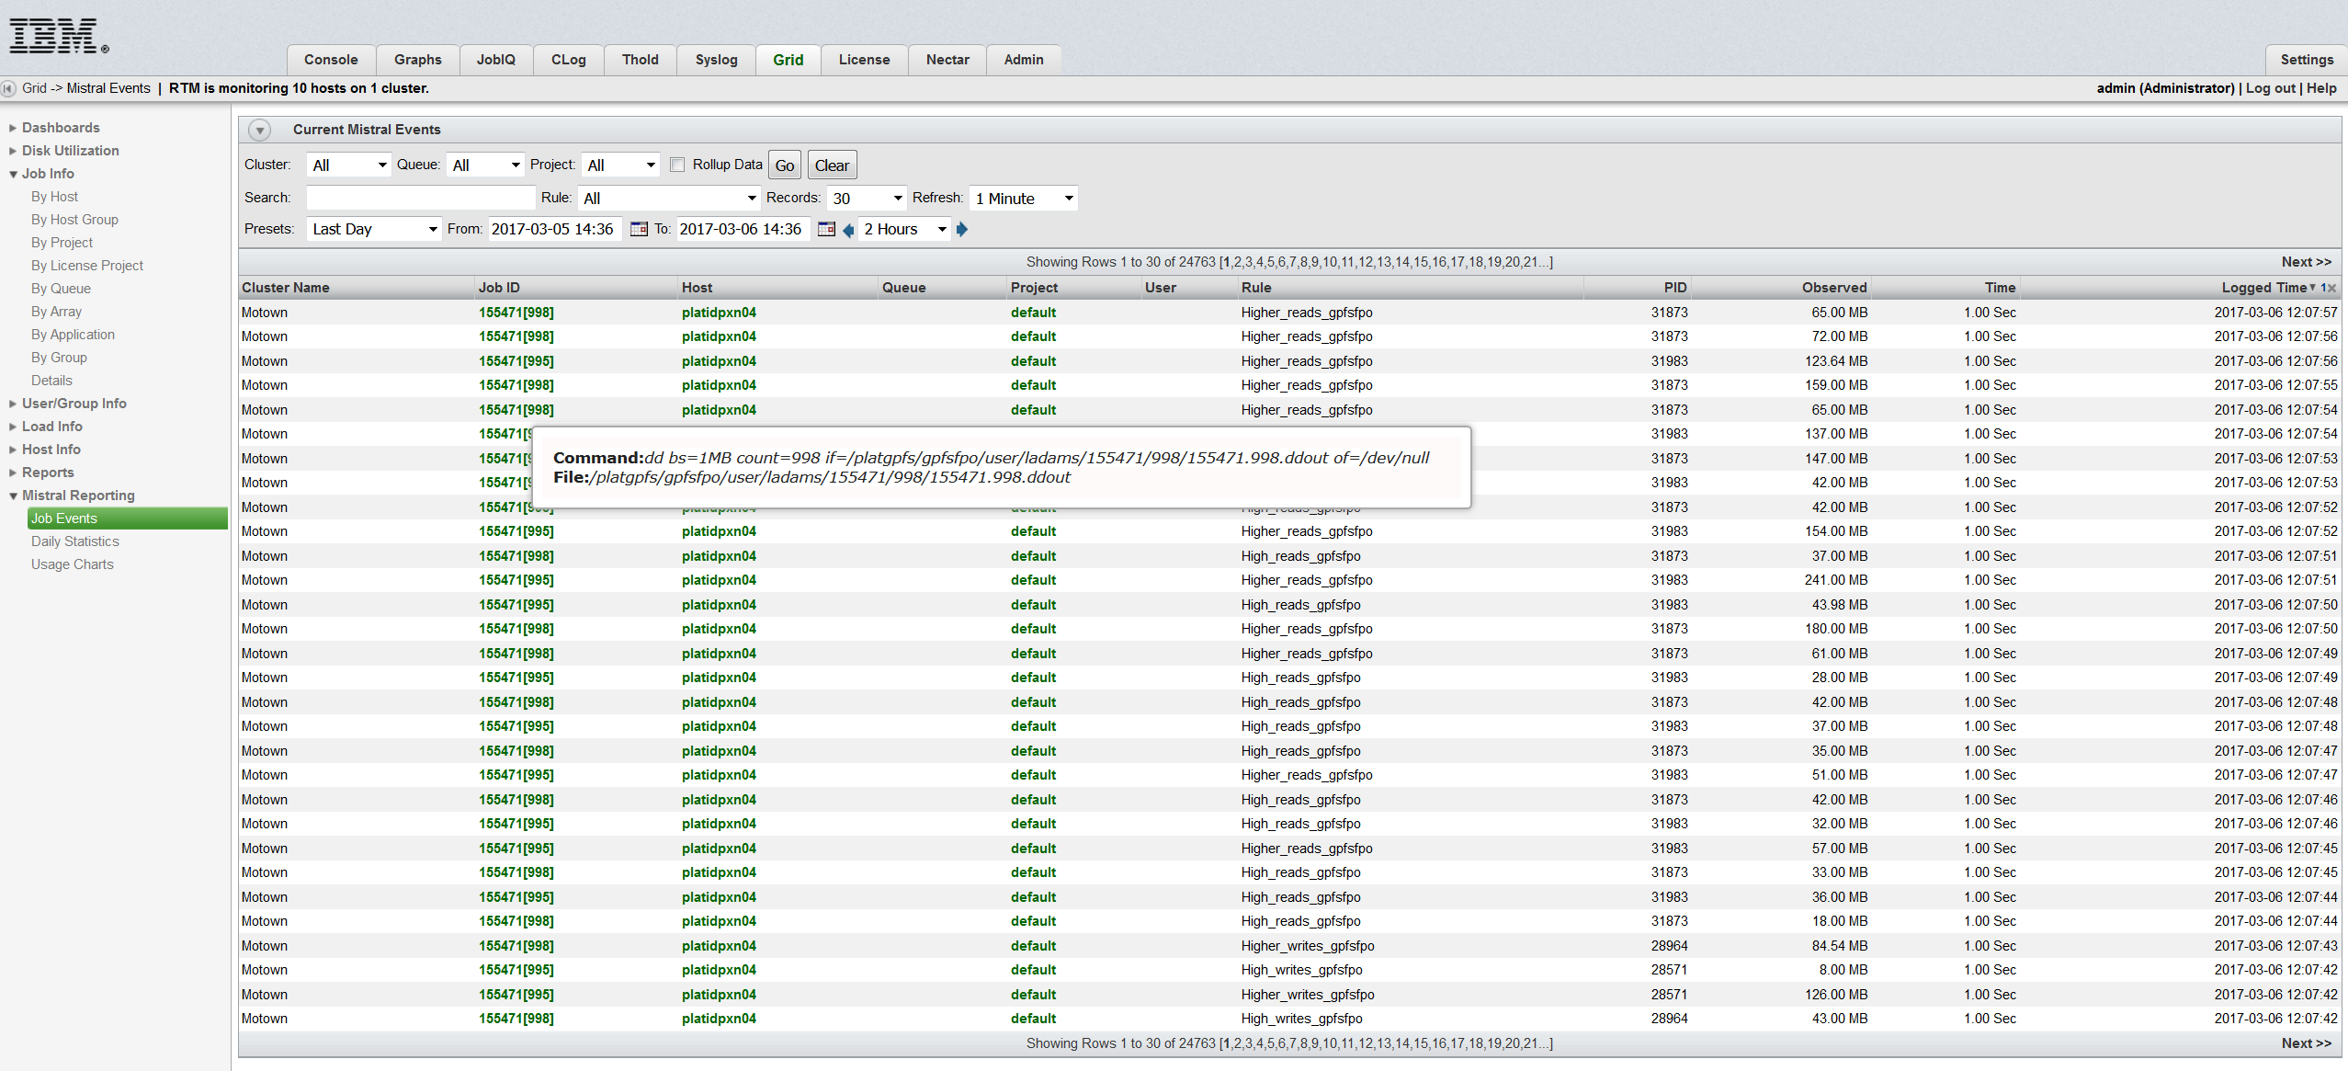
Mistral RTM integration: Who is using the storage?
Table showing:
Cluster name
Job ID
Host Queue
Project
User
Mistral I/O rule
PID
I/O observed (MB)
Time frame
Log time
Notes:
Mistral is very different from other storage analytics tools because it runs at the application level and it can run all the time on your whole cluster. You can integrate it with your scheduler in order to wrap up every job and be invisible to users or you can launch it directly as shown by wrapping up just one command.

Slide 19

Customer case study:
Protecting the file system from R&D jobs
R&D jobs often seg fault and this exposes Mistral.
Solution
1. Guess which job is causing the problem the old way
2. Check problem jobs by profiling I/O in detail
Check for:
  Too much I/O
  Small reads and writes
  Peaks in I/O bandwidth
  Creation or deletion of small files
  Meta data operations: open(), stat()
  Random access patterns
Make every user an I/O expert
Mistral
Job
Notes:
Here we come to a different use case for Mistral. It’s better to catch bad IO patterns before they reach the cluster and before they are run at scale. You can do this by running regular healthchecks with Mistral. We supply contracts with extra rules to detect a range of bad I/O patterns. You can run this on new jobs, on a random selection once a month or you can set up a special profiling queue on your scheduler where users can validate their applications for the cluster.

Slide 20
Summary
Profile profile profile.
Protect your storage by monitoring the whole cluster for rogue jobs.
Prevent bad I/O patterns by running health checks on new work flows.
Optimise applications for shared storage and optimise the compute and storage infrastructure for the jobs.
Mistral: wide-scale I/O profiling and load balancing for shared storage
www.ellexus.com
Notes:
In summary…

Slide 21
Thank you
Please get in touch for more information.
Dr Rosemary Francis
CEO and Co-founder
Ellexus Ltd
St John's Innovation Centre, Cowley Road, Cambridge CB4 0WS, UK
info@ellexus.com
01223 123456
Mistral: wide-scale I/O profiling and load balancing for shared storage
www.ellexus.com

