Slide 1

Challenges in Tracing
Vasily Tarasov
5 April 2017
Notes:
- Introduce: VT, IBM, Research division, at Almaden, and I

Slide 2
Outline
Tracing in Spectrum Scale
  High-level design
  Stats & challenges
FlexTrace
TraceAnz
Acknowledgement: Marc Vef from University of Mainz
Notes:
Say that I did not implement it. Jim Wyllei implemented most. Marc Vef.

Slide 3

Traces
Execution
Fasd#include <iostream>
using namespace std;
void Store(){
cout << "The Item store is not finished yet\n" << endl;
int Mainmenu();
Mainmenu();
}
void Character(){
int PlayerHp, PlayerStr, PlayerMana;
cout << "Your character has:\n\n";
cout << PlayerHp << " Health" << endl;
cout << PlayerStr << " Strength" << endl;
cout << PlayerMana << " Mana" << endl;
cout << endl;
int Mainmenu();
Mainmenu();
}
void Inventory(){
cout << "Your inventory contains:\n" << endl;
int Mainmenu();
Mainmenu();
}
void Wilderness(){
cout << "You search the Jungle and find:\n" << endl;
string Creatures[10];
Creatures[0] = "1";
Creatures[1] = "2";
Creatures[2] = "3";
Creatures[3] = "4";
cout << Creatures << " Is really dangerous " << endl;
int Mainmenu();
Mainmenu();
}
void Mainmenu(){
string choice;
cout << "1: Attack creature" << endl;
cout << "2: Buy equipment" << endl;
cout << "3: Inventory" << endl;
cout << "4: Stats" << endl;
// invalid option returns to this
InvalidOption:
cin >> choice;
if (choice == "1"){
Wilderness ();
}
else if (choice == "2"){
Tracepoints
  Strategically placed in the code
  Conditionally generate messages
  Free-form text with a timestamp
Much more detailed than logs
Use cases
  Understand how a system operates
  Debug issues
  Analyze performance/workloads
TRACEPOINT( );
message

Slide 4
Tracing in Spectrum Scale
~64 subsystems
  VFS, NSD, Threads, Mutexes, …
~16 priority levels
  64-byte array
Global on/off switch
Low overhead when off and when on
  1 comparison – for globally off
  2 comparisons – for globally on and locally off
  (2 comparisons + trace record generation) – for globally and locally on
20,000+ tracepoints
  Some on hot code paths

Slide 5
Tracing optimizations GPFS
Trace Buffer
Code inlining (no function calls)
Zero-copying
Binary trace records
  Additional formatting step
Overwrite and blocking modes
Compression
Per-CPU structures
Trace Record
Trace Record
Trace Record
Trace Record
Trace Record
Trace Record
Binary Trace
File
Formatted Trace
File
Disk

Slide 6
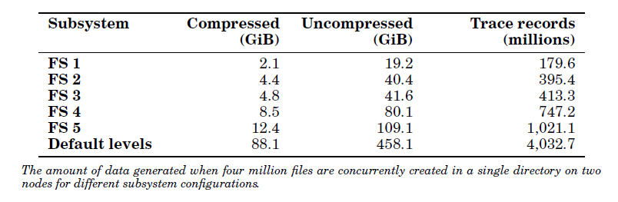
Traces Are Large
High overheads to collect
Long transfer time
Long analysis time

Slide 7
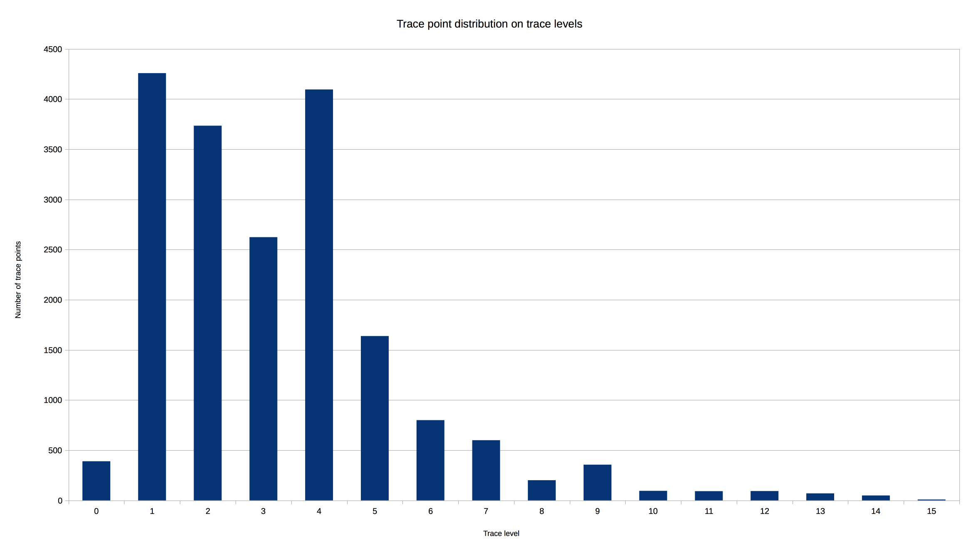
Distribution Over Levels
Number of tracepoints
Trace level

Slide 8
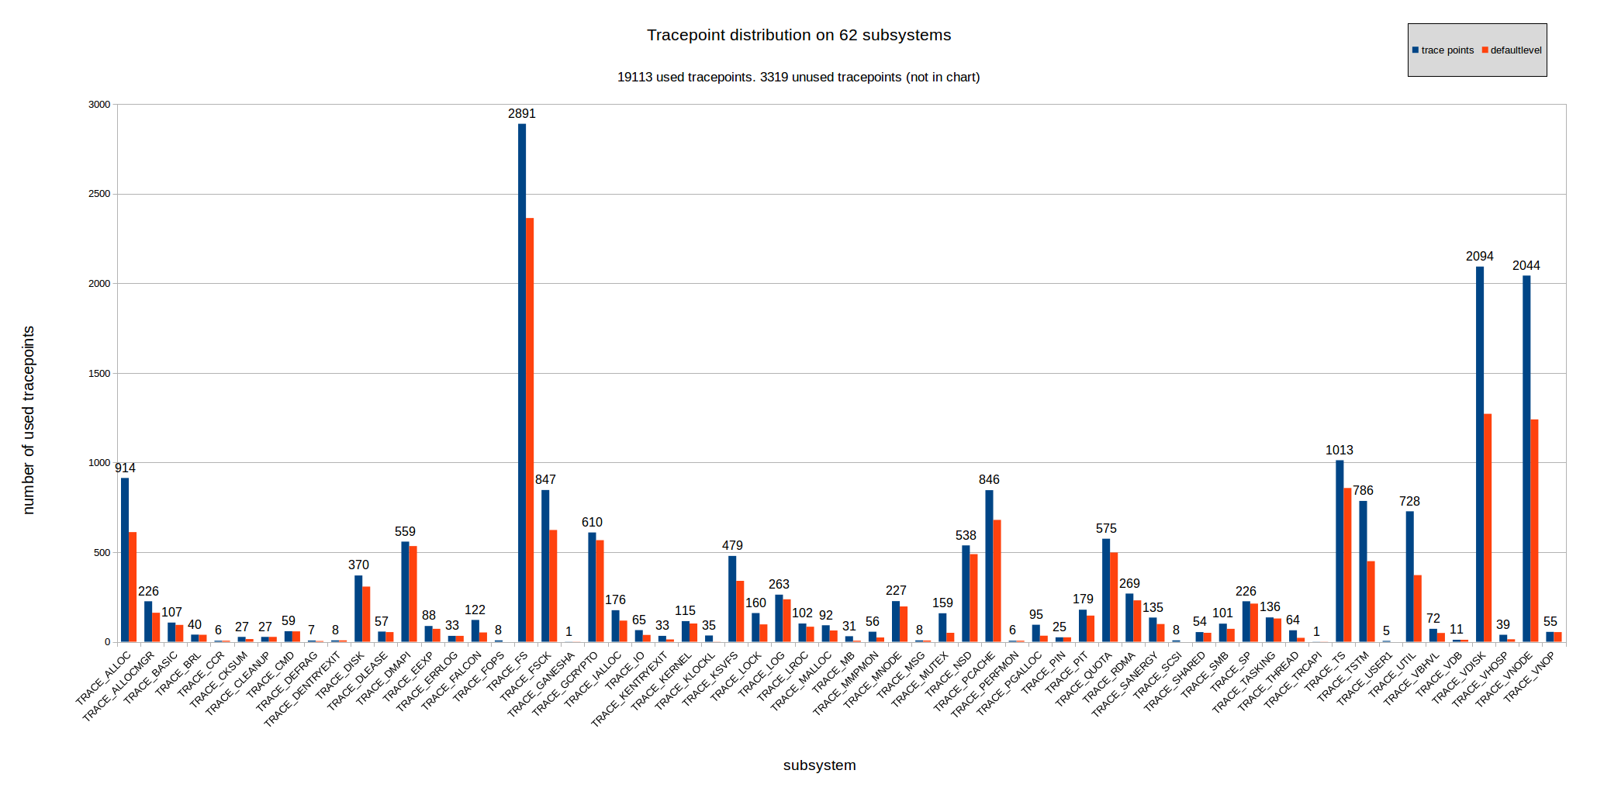
Over Subsystems
Number of tracepoints
Subsystem

Slide 9
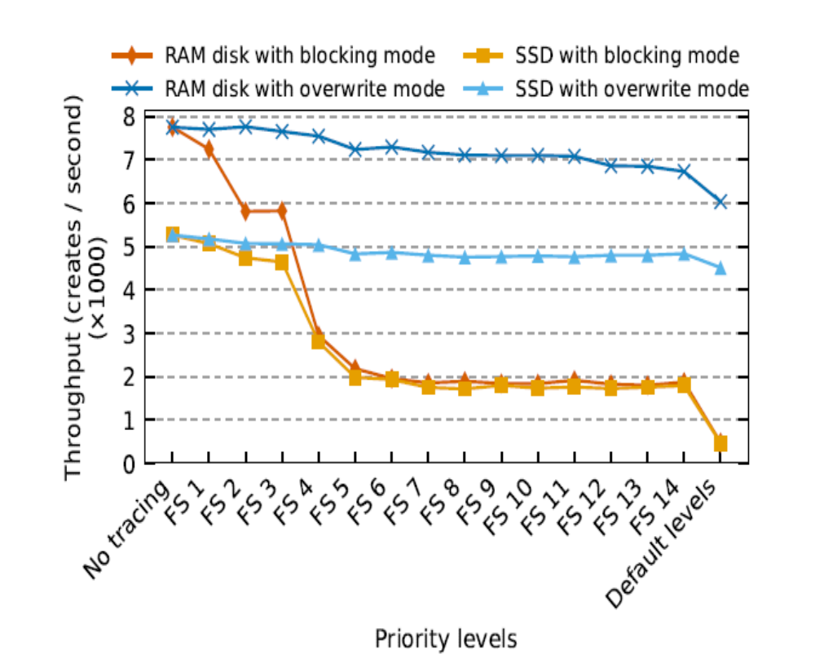
Performance

Slide 10
FlexTrace: Motivation
VFS
RPC

Slide 11
FlexTrace
Enable individual tracepoints
  mmtracectl --set --trace=”VFS_READ_ENTER 1 VFS_READ_EXIT 1” enables trace points
  mmtracectl --set --trace=”VFS_READ_ENTER 0 VFS_READ_EXIT 0” disables trace points
  mmtracectl --set --trace=“bitmapall 0” resets the complete bitmap
  mmfsadm showtracebitmap shows all enabled trace points
Move decision on tracepoint “cuts” from development to run time
Tracing profiles
  mmtracectl --set --trace-profile=creates.ftr enables all trace points in the profile
Existing subsystems/levels can be replaced with profiles
Analysis-tailored profiles

Slide 12
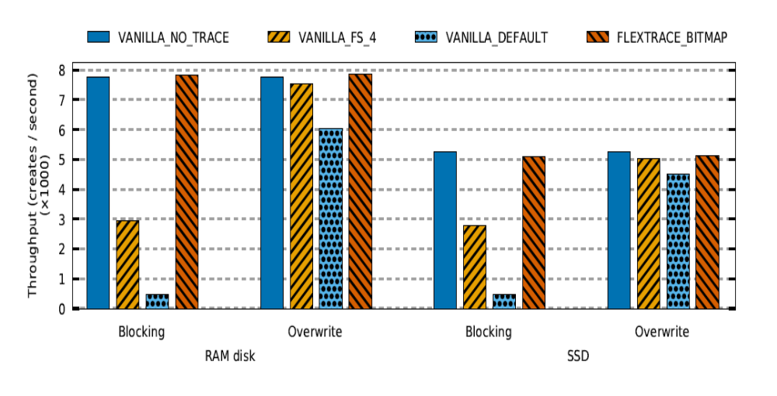
FlexTrace: Evaluation
Bitmap overhead – encouraging preliminary results

Slide 13


TraceAnz
Collect
TRC
RPT
TRC
RPT
TRC
RPT
TRC
RPT
TRC
RPT
TRC
RPT
TRC
RPT
TRC
RPT
Extract
cruxes
CRUX
CRUX
CRUX
CRUX
Visualize
cruxes
CRUX
CRUX
CRUX
CRUX
Notes:
Trace Sampling
Fast trace collection
Limiting higher levels of collection to more suspcicios nodes

Slide 14
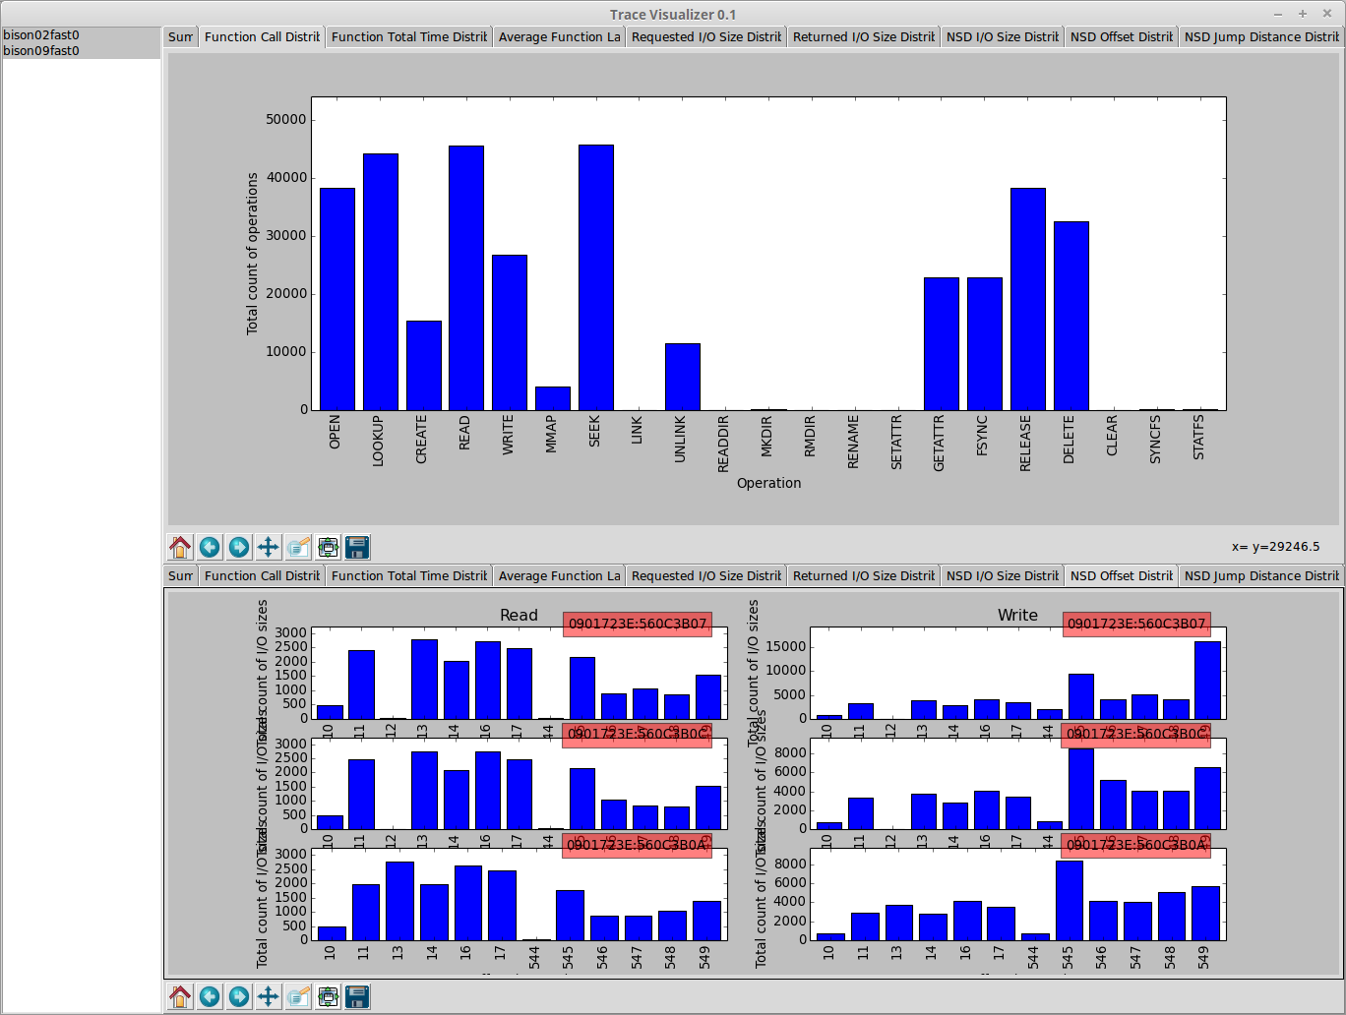
TraceAnz: Early Prototype

Slide 15
TraceAnz: Real-world limitations
Long delivery cycles
  Small modifications
  New analysis
Dependency hell
No access to traces and cruxes
Narrow applicability

Slide 16



TraceAnz: Web-service
GPFS
NFS
Blktrace
…
Users
Browser
Vasily Tarasov - vtarasov@us.ibm.com

